Slide 1
Windows Server 2019
INTRODUCTION
HEARTLAND BUSINESS SYSTEMS
Presented by: Adam Clifford, Enterprise Engineer, Heartland Business Systems
March 4, 2019
HBS PARTNERSHIP
CONFIDENTIAL. © 2016 HEARTLAND BUSINESS SYSTEMS
HBS.net

Slide 2
Agenda
Information and Licensing
Pillars for new features
Windows Admin Center
Hybrid
Hyper Converged Infrastructure
Security
Application Innovation
Server Core
Q&A
INTRODUCTION
Overview
HBS PARTNERSHIP
CONFIDENTIAL. © 2016 HEARTLAND BUSINESS SYSTEMS
HBS.net

Slide 3
Release Channels
Windows Server 2019
Overview
Windows Server 2019 is a LTSC
5 years of mainline support
5 years of extended support
Builds on and incorporates enhancements from the SAC releases
Server 2019 includes the Desktop Experience
Semi-Annual channel releases (1709, 1803, or 1809) are Core and Nano Server only
Windows Server 2019 is the best option for production environments
The minimum requirement to add a Windows Server 2019 Domain Controller is a Windows Server 2008R2 functional level
HBS PARTNERSHIP
CONFIDENTIAL. © 2016 HEARTLAND BUSINESS SYSTEMS
HBS.net

Slide 4
Licensing
Windows Server 2019
Overview
Basically the same as Server 2016
Per core licensing with a server requiring a minimum of 16 cores
Two VM’s on a standard license, and unlimited on Datacenter
Unlimited containers
Three versions to choose from
HBS PARTNERSHIP
CONFIDENTIAL. © 2016 HEARTLAND BUSINESS SYSTEMS
HBS.net

Slide 5
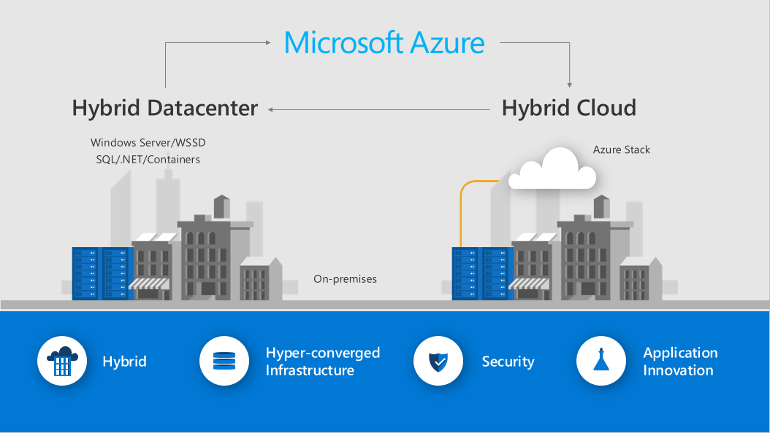
Feature Pillars
Windows Server 2019
Windows Admin Center
HBS PARTNERSHIP
CONFIDENTIAL. © 2016 HEARTLAND BUSINESS SYSTEMS
HBS.net

Slide 6
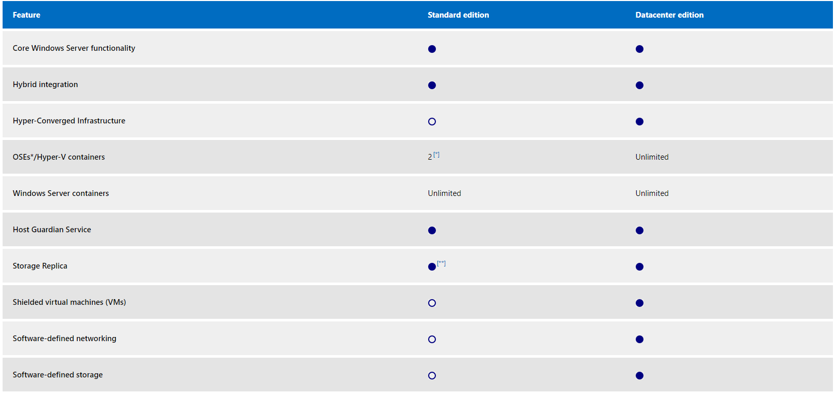
Feature differentiation
Windows Server 2019
Overview
HBS PARTNERSHIP
CONFIDENTIAL. © 2016 HEARTLAND BUSINESS SYSTEMS
HBS.net

Slide 7
Windows Admin Center
Windows Server 2019
Windows Admin Center
HBS PARTNERSHIP
CONFIDENTIAL. © 2016 HEARTLAND BUSINESS SYSTEMS
HBS.net
Notes:
Big idea!
How many of you are running this today?
IT teams are asked to do more with less. WAC is a great tool to help simply management of your infrastructure and free up admin time for other tasks
Can manage server 2012 and higher. Limited functionality on 2008r2

Slide 8
Windows Admin Center complements existing management solutions
Windows Server 2019
Windows Admin Center
Azure security and management
Cloud/hybrid deployments
System Center
Windows Admin Center
Windows Admin Center
RSAT
Remote Desktop + in-box tools
HBS PARTNERSHIP
Small deployments
CONFIDENTIAL. © 2016 HEARTLAND BUSINESS SYSTEMS
Large deployments
HBS.net

Slide 9
Replicates Server manager and 20+ MMC snap ins
Windows Server 2019
Windows Admin Center
Displaying resources and resource utilization
Certificate Management
Managing Devices
Event Viewer
File Explorer
Firewall Management
Managing Installed Apps
Configuring Local Users and Groups
Network Settings
Viewing/Ending Processes and Creating Process Dumps
Registry Editing
Managing Scheduled tasks
Managing Windows Services
Enabling/Disabling Roles and Features
Managing Hyper-V VMs and Virtual Switches
Managing Storage
Managing Storage Replica
Managing Windows Updates
PowerShell console
Remote Desktop connection
HBS PARTNERSHIP
CONFIDENTIAL. © 2016 HEARTLAND BUSINESS SYSTEMS
HBS.net
Notes:
For some management tasks, like firewall rules, I prefer WAC to the control panel equiv
Management is performed via remote powershell and wmi over wrm
Optioanlly, you can now Lock down some management protocols on your server VLAN to only allow access from WAC
Publish WAC externally, preferably behind Azure Web application gateway to allow for remote access and management.
How man of you have every checked email or surfed the web from a server? Even once? One of the best ways to promote good server hygiene is not to log into your servers!
Ending RDP sessions without signing out also leaves credentials stored in memory. This can also be exploited by attackers to gain admin access after compromising a machine.

Slide 10
That’s WAC
Windows Server 2019
Windows Admin Center
Free to download and use
Two installation modes
Management Gateway on Windows Server 2019
Desktop mode on Windows 10
Role based administration
Saved “managed as” accounts
Fully extendable
HPE hardware management
Lenovo hardware management
Windows Defender Security Center
Pure Storage
Many other vendor integrations
Manages on premises servers and Windows 10 workstations
Manages Azure resources as well
HBS PARTNERSHIP
CONFIDENTIAL. © 2016 HEARTLAND BUSINESS SYSTEMS
HBS.net

Slide 11
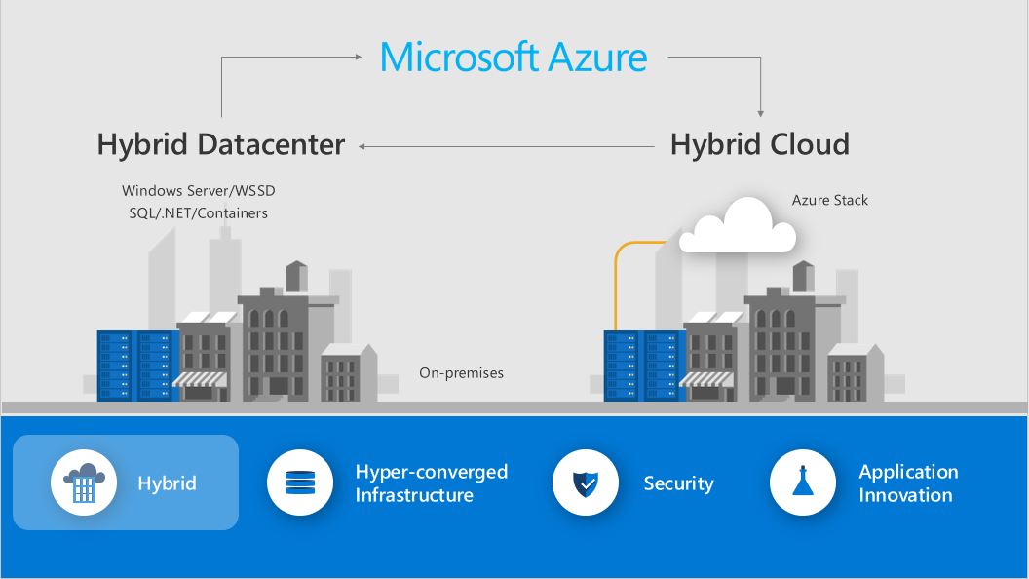
Hybrid
Windows Server 2019
Windows Admin Center
HBS PARTNERSHIP
CONFIDENTIAL. © 2016 HEARTLAND BUSINESS SYSTEMS
HBS.net
Notes:
What is your could strategy. Raise hands for 100% cloud, 100% on prem or hybrid.
Microsoft knows hybrid is a common configuration for most customers. Many new features in 2019 are designed to promote this

Slide 12
Azure Network Adapter
Windows Server 2019
Azure Network Adapter
More and more on-premises workloads require connectivity to Azure resources. Connecting these on-premises workloads to their Azure resources traditionally requires an Express Route, Site-to-Site VPN, or Point-to-Site VPN connection. Each of these options require multiple steps and expertise in both networking and certificate management, and in some cases, infrastructure setup and maintenance.
Now, Windows Admin Center enables a one-click experience to configure a point-to-site VPN connection between an on-premises Windows Server and an Azure Virtual Network. This automates the configuration for the Azure Virtual Network gateway as well as the on-premises VPN client.
Windows Admin Center and the Azure Network Adapter makes connecting your on-premises servers to Azure a breeze!
Point-to-Site connections do not require a VPN device or a public-facing IP address
HBS PARTNERSHIP
CONFIDENTIAL. © 2016 HEARTLAND BUSINESS SYSTEMS
HBS.net
Notes:
Do you have edge servers in schools or admin offices outside of your primary DC that need Azure access? ANA is a great way to connect to azure without adding firewalls or security gateways to maintain a VPN connection.

Slide 13
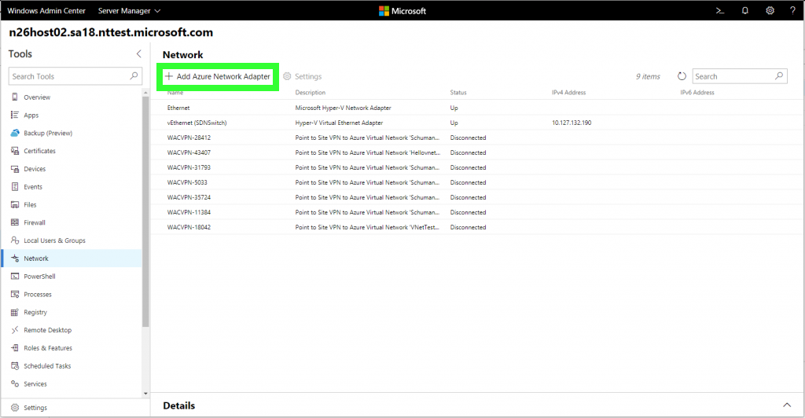
Demo
Windows Server 2019
Azure Network Adapter
HBS PARTNERSHIP
CONFIDENTIAL. © 2016 HEARTLAND BUSINESS SYSTEMS
HBS.net
Notes:
Click add Azure network connector

Slide 14
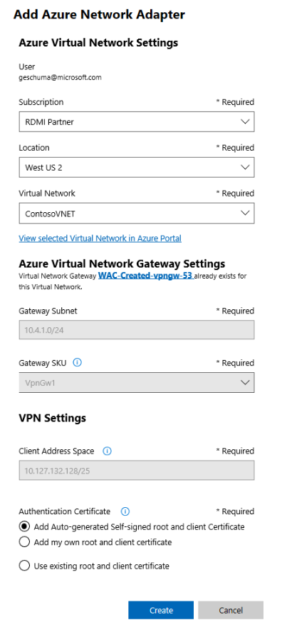
Demo
Windows Server 2019
Previously creating hybrid cloud connectivity required expertise in networking, certificate management, and even infrastructure setup and maintenance. Now with the Azure Network Adapter in Windows Admin Center, hybrid connectivity can be configured with the click of a button! The Azure Network Adapter automates the configuration of the Azure Virtual Network gateway and VPN client installation for you!
The Azure Network adapter can take up to 25 minutes to provision if the virtual network gateway needs to be created as well.
Azure Network Adapter
HBS PARTNERSHIP
CONFIDENTIAL. © 2016 HEARTLAND BUSINESS SYSTEMS
HBS.net
Notes:
Choose your subscription, location, virtual network, and then select one of your Azure virtual networking gateways.
No advanced networking knowledge is required.
With ANA you can connect to Azure from a 2019 server in just a few clicks. It’s that easy

Slide 15
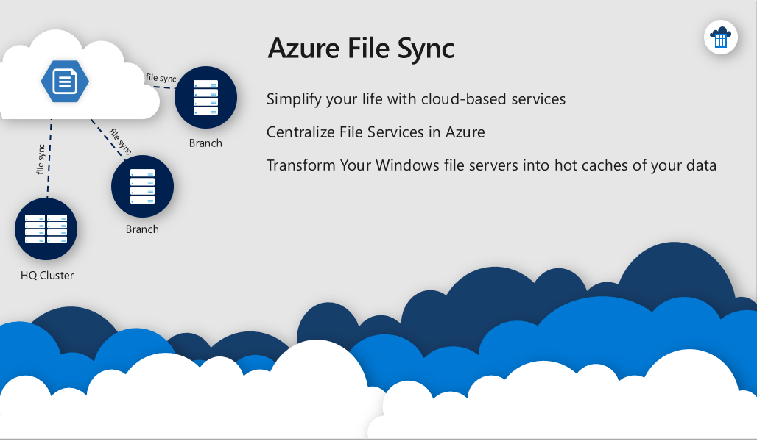
Azure File Sync
Windows Server 2019
Azure Network Adapter
HBS PARTNERSHIP
CONFIDENTIAL. © 2016 HEARTLAND BUSINESS SYSTEMS
HBS.net

Slide 16
Azure File Sync
Windows Server 2019
Azure File Sync is a Microsoft feature released in July 2018. It enables to synchronize multiple On-Premise file servers with Azure. In other words, we can replace DFS-R for branch office. Azure File Sync brings also a tiering feature that enables to cache in On-Prem servers the most used files (based on the access data) and to keep in Azure the others. The data can be protected with Azure Backup to avoid to manage backup in each On-Prem file servers and in case of disaster, the data remains in Azure.
Windows, MacOS, and Linux can also mount Azure File Shares with SMB3 for remote access.
New for 2019: Up to 100 TB per file share!!
Use Cases:
Virtually bottomless local file servers with tiering for commonly accessed files.
Replacement for DFS
When combined with Azure backup, provides HA and DR for your file servers
Lift and Shift applications to the cloud that require a file server to store data
Azure Network Adapter
HBS PARTNERSHIP
CONFIDENTIAL. © 2016 HEARTLAND BUSINESS SYSTEMS
HBS.net
Notes:
Keep data in sync between multiple on prem servers, or sync a replica to the cloud.
Set Tieiring thresholds for % of disk space free and Azure Sync will maintain that level of available space by offloading cold files to Azure.
A heap map is generated to by looking ata ccess patterns to determine what hot files need to be cached locally, and what files can be offloaded.
Synced only files are still visible in Explorer but do not consume space on disk.

Slide 17
Azure Backup
Windows Server 2019
Azure Backup
With Windows Admin Center you have a great new web-based management experience for Windows Server. With Microsoft efforts to bring Hybrid Cloud capabilities closer to your on-premises systems, they added support for Azure Backup in Windows Admin Center. This allows you to simply configure Azure Backup for your Windows Server with a couple of clicks.
Setting up a cloud backup of a server is simple and saves you a lot of time and resources. It is especially great, if you have a small environment in your datacenter or hosted at a different service provider, where having an own backup infrastructure doesn’t make much sense.
HBS PARTNERSHIP
CONFIDENTIAL. © 2016 HEARTLAND BUSINESS SYSTEMS
HBS.net

Slide 18
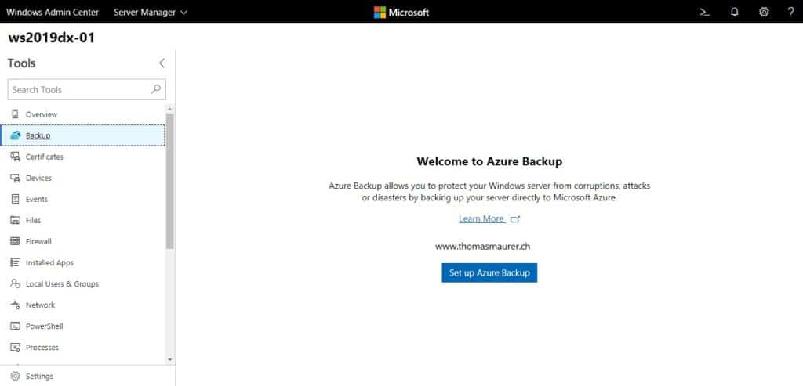
Demo
Windows Server 2019
Azure Backup
HBS PARTNERSHIP
CONFIDENTIAL. © 2016 HEARTLAND BUSINESS SYSTEMS
HBS.net
Notes:
First you will need to register your Windows Admin Center to Microsoft Azure. This can be done in the settings of Windows Admin Center. If you haven’t done this yet, the wizard will guide you through. After this is done you can go to the Azure Backup Extension in Windows Admin Center and sign in. You can now configure Azure Backup directly in Windows Admin Center.

Slide 19
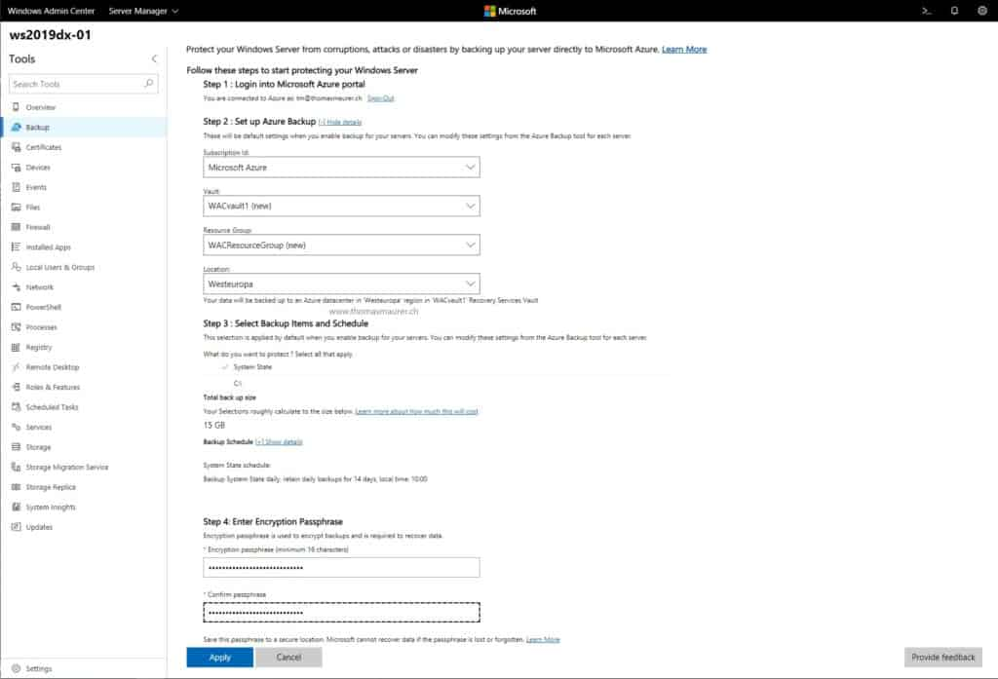
Demo
Windows Server 2019
Azure Backup
HBS PARTNERSHIP
CONFIDENTIAL. © 2016 HEARTLAND BUSINESS SYSTEMS
HBS.net
Notes:
Configuration:
Choose our subscription, storage location, and region
Select backup items and schedule.
Do I want just system state? C: drive? Additional drive letters will show up as well
Total backup size is shown
Retention policy is right there. DO you have legal requirements to store data for 3 years? 5? 7?
Backup encryption.
Protection against ransomware – I don’t want to pay that.
Protecting your data with a strong encryption password protects your backups from the bad guys.
Backups are unavialble for deletion or modification until they are unencrypted by your passphrase.

Slide 20
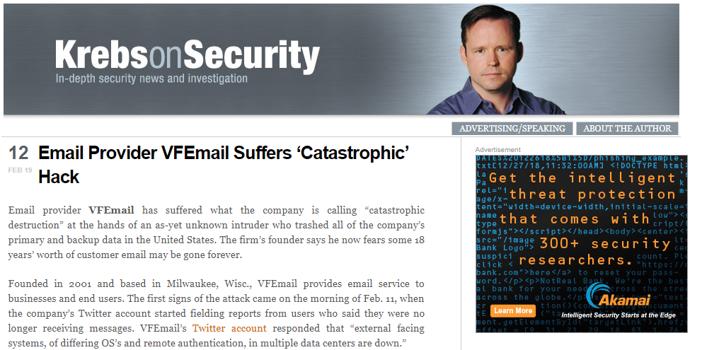
Why encrypt your backups?
Windows Server 2019
Azure Backup
“At this time, the attacker has formatted all the disks on every server,” wrote VFEmail. “Every VM [virtual machine] is lost. Every file server is lost, every backup server is lost.
HBS PARTNERSHIP
CONFIDENTIAL. © 2016 HEARTLAND BUSINESS SYSTEMS
HBS.net
Notes:
How many of you have heard about the recent attack on VFEmail?
Their production data AND backups were both targeted by a malicious attacker.
They were able to access and delete the backups because they were both online and unencrypted.

Slide 21
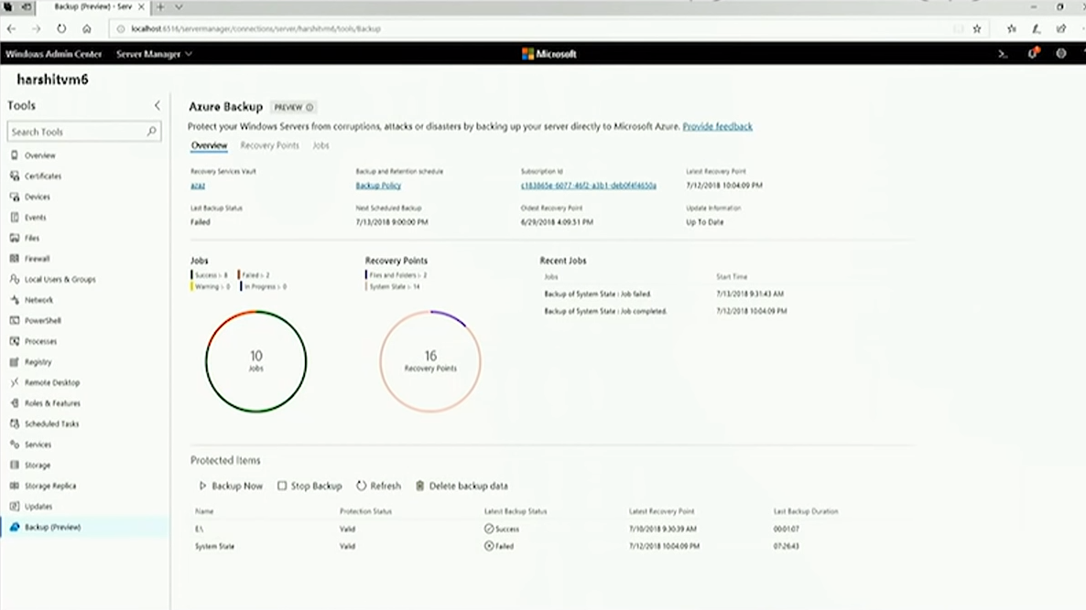
Demo
Windows Server 2019
Azure Backup
HBS PARTNERSHIP
CONFIDENTIAL. © 2016 HEARTLAND BUSINESS SYSTEMS
HBS.net
Notes:
I can see my overview
Current running jobs
Last Job status
All of my recovery points etc
Deep links that take you into Azure for more information.

Slide 22
Azure Update Management
Windows Server 2019
Azure Update Management
With Windows Admin Center you can use the updates tool today to easily deploy updates across my servers one at a time.
What If I want a centralized way to deploy updates across all of my servers organization wide? What if I also want see the compliance status for all of my servers on a single pane of glass.
Azure Update Manager is solution from Azure Monitor that does just that.
Using Windows Admin Center I can easily onboard my existing managed servers to Azure Update Management giving you an easy centralized management experience.
HBS PARTNERSHIP
CONFIDENTIAL. © 2016 HEARTLAND BUSINESS SYSTEMS
HBS.net
Notes:
Great alternative to SCCM if you don’t already have it
Requires an Azure monitor workspace with an installed OMS agent to send log and server data to Azure
Azure monitor can also be used for single pane of glass monitoring and dashboarding, as well as utilizing Azure automation to create self healing alerts suing Azure automation runbooks.

Slide 23
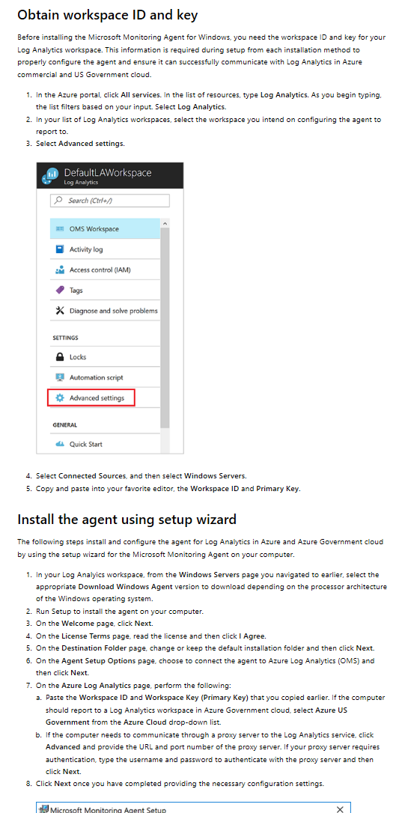
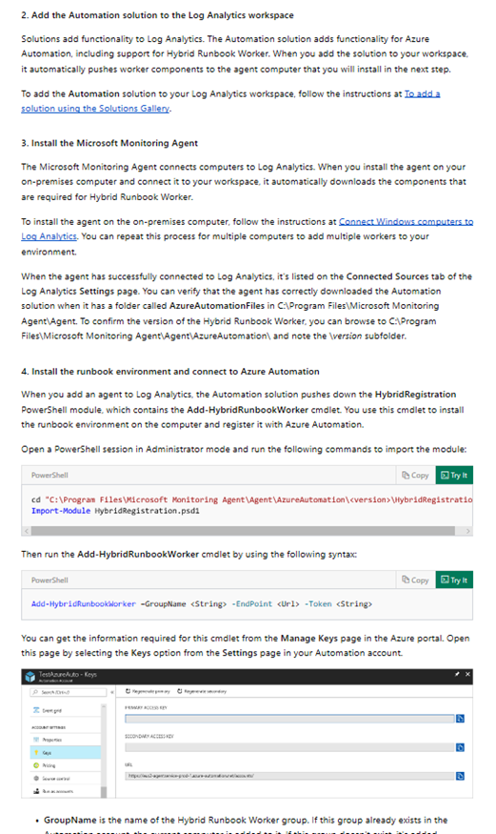
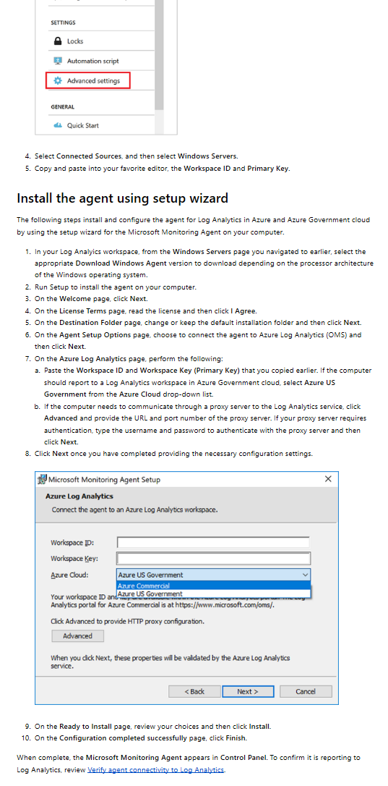
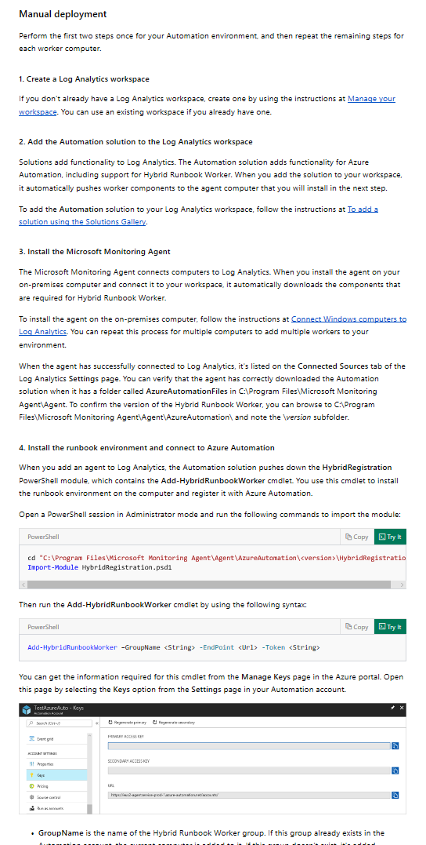
Azure Update Management
Windows Server 2019
Azure Update Management
HBS PARTNERSHIP
CONFIDENTIAL. © 2016 HEARTLAND BUSINESS SYSTEMS
HBS.net
Notes:
Before integration with WAC, getting servers enrolled in AUM, was well documented but tedious.
The steps looked something like this. I couldn’t fit them all on a single slide

Slide 24
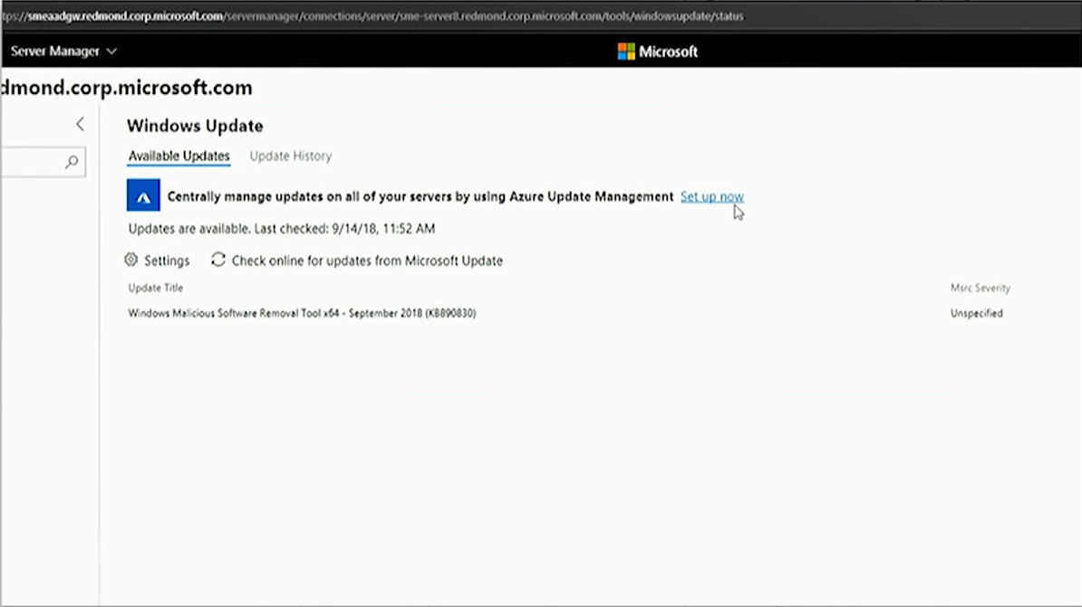
Demo
Windows Server 2019
Azure Update Management
HBS PARTNERSHIP
CONFIDENTIAL. © 2016 HEARTLAND BUSINESS SYSTEMS
HBS.net
Notes:
ON the Windows update blasé in WAC, you’ll see a helpful notification that Azure can centrally manage your updates globally by connecting to update manager.
Click set up now

Slide 25
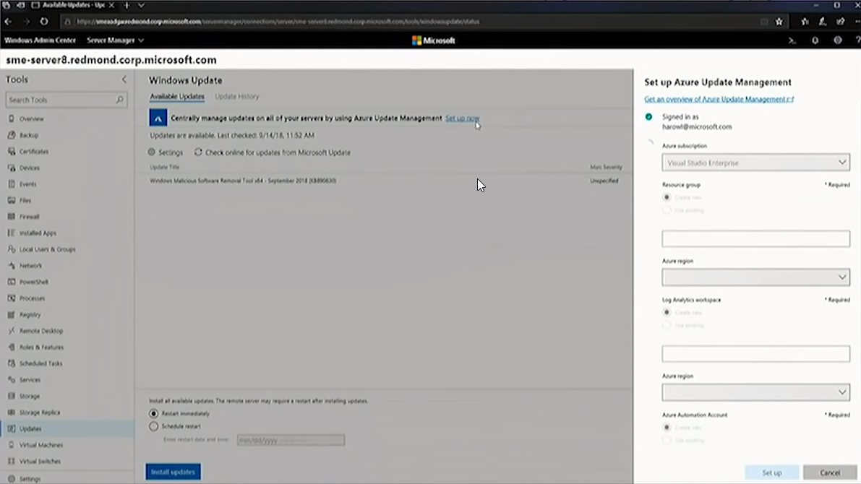
Demo
Windows Server 2019
Azure Update Management
HBS PARTNERSHIP
CONFIDENTIAL. © 2016 HEARTLAND BUSINESS SYSTEMS
HBS.net
Notes:
Now all I have to do is select my subscription
The location of the resources I want to use… I select my resource group, and then I simply create a new log analytics workgroup, or select an existing one if I’m already using it today.
Windows admin center with then deploy the OMS agents to all of the servers automatically, and make sure that the services are provisioned and configured in Azure for you, and connecting everything together.

Slide 26
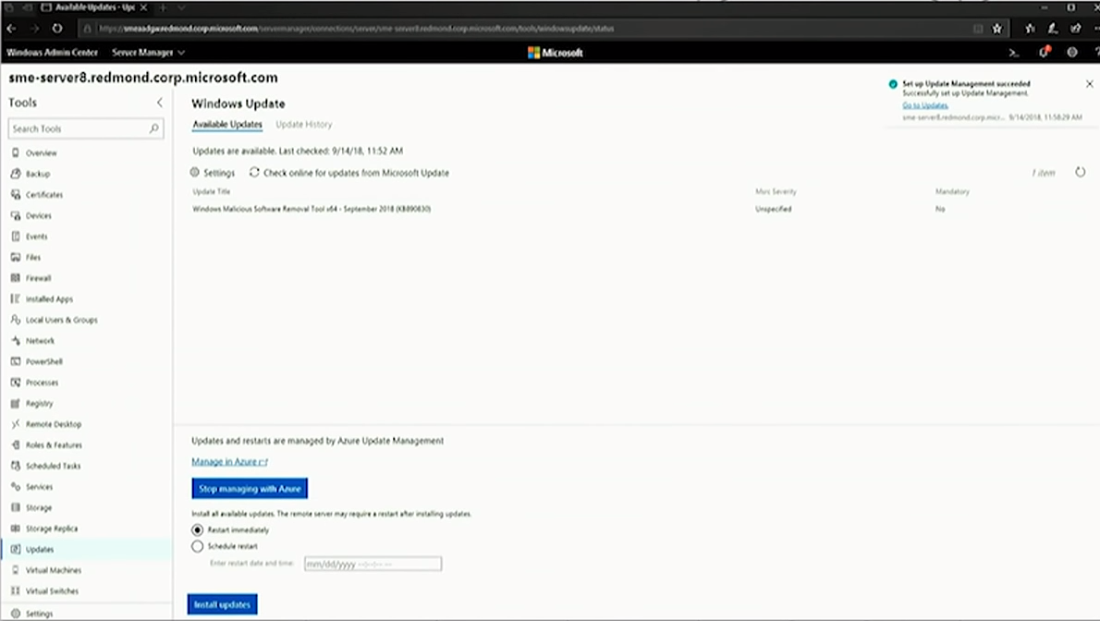
Demo
Windows Server 2019
Azure Update Management
HBS PARTNERSHIP
CONFIDENTIAL. © 2016 HEARTLAND BUSINESS SYSTEMS
HBS.net
Notes:
Once setup completes the interface will update.
I can still manually install updates from windows update manually, or I can click the deep link into azure to see and manage the update status on all of my servers

Slide 27
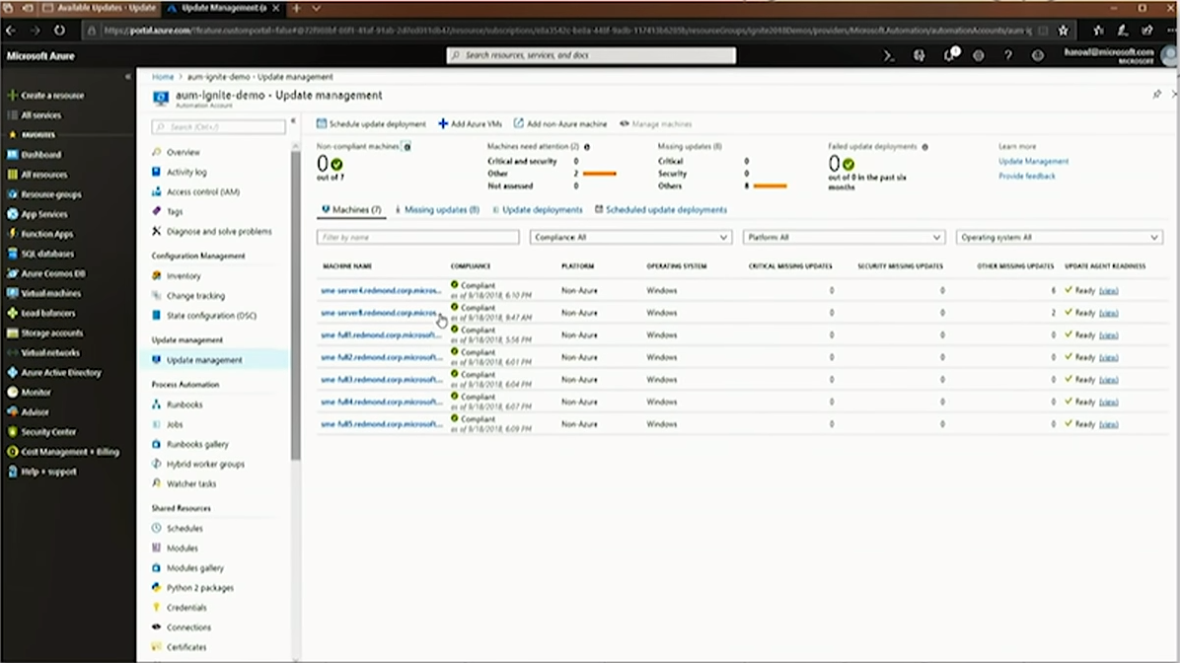
Demo
Windows Server 2019
Azure Update Management
HBS PARTNERSHIP
CONFIDENTIAL. © 2016 HEARTLAND BUSINESS SYSTEMS
HBS.net
Notes:
Here is my centralized view… All of my servers are compliant. I can also use the schedule update button at the top left to schedule updates across all of my servers.

Slide 28
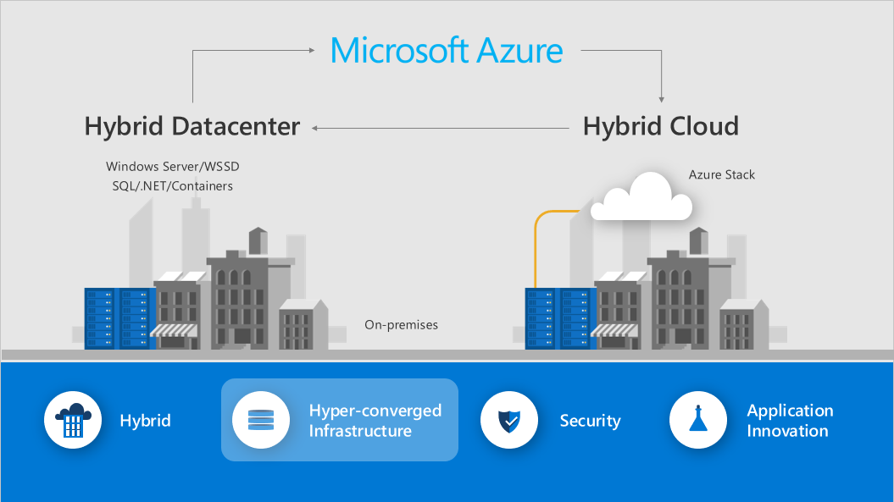
Hyper-converged Infrastructure
Windows Server 2019
HCI
HBS PARTNERSHIP
CONFIDENTIAL. © 2016 HEARTLAND BUSINESS SYSTEMS
HBS.net

Slide 29
Storage Class Memory
Windows Server 2019
HCI
History of flash memory interconnects
USB
SATA & SAS
PCI
NVMe
Each time we add a new connection we’re moving the flash storage closer and closer to the processor.
Why are we doing this?
Drive up performance
Reduce latency
Storage Class memory fits in a DIMM socket right next to the processor.
HBS PARTNERSHIP
CONFIDENTIAL. © 2016 HEARTLAND BUSINESS SYSTEMS
HBS.net

Slide 30
Storage Class Memory
Windows Server 2019
HCI
HBS PARTNERSHIP
CONFIDENTIAL. © 2016 HEARTLAND BUSINESS SYSTEMS
HBS.net

Slide 31
Storage Class Memory
Windows Server 2019
HCI
Insanely fast high speed cache!
Non-volatile and persistent storage
Intel Optane chips come in sizes up to 512 GB
Natively Supported in Server 2019
Also works with Storage Spaces Direct
HBS PARTNERSHIP
CONFIDENTIAL. © 2016 HEARTLAND BUSINESS SYSTEMS
HBS.net
Notes:
At Ignite this year MS showed off a 12 node server cluster filled with Flash memory and Opdate chips. They were able to show a simulated workload that was able to provide HyperV virtual amchines with almost 14 million IOPS per second. That almost broken my brain.

Slide 32
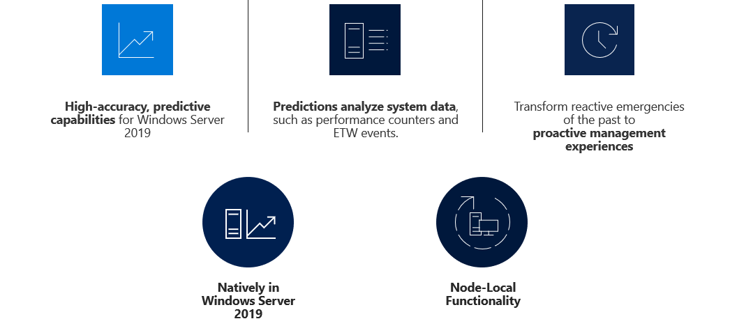
System Insights
Windows Server 2019
System Insights
HBS PARTNERSHIP
CONFIDENTIAL. © 2016 HEARTLAND BUSINESS SYSTEMS
HBS.net
Notes:
Here is my centralized view… All of my servers are compliant. I can also use the schedule update button at the top left to schedule updates across all of my servers.

Slide 33
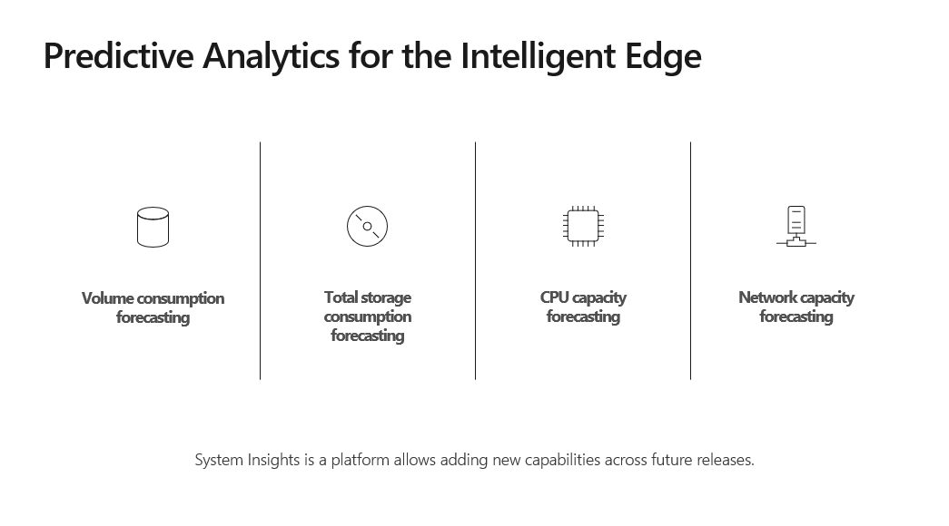
System Insights
Windows Server 2019
System Insights
HBS PARTNERSHIP
CONFIDENTIAL. © 2016 HEARTLAND BUSINESS SYSTEMS
HBS.net
Notes:
Here is my centralized view… All of my servers are compliant. I can also use the schedule update button at the top left to schedule updates across all of my servers.

Slide 34
Demo
Windows Server 2019
System Insights
Volume consumption forecast & remediation
HBS PARTNERSHIP
CONFIDENTIAL. © 2016 HEARTLAND BUSINESS SYSTEMS
HBS.net
Notes:
Here is my centralized view… All of my servers are compliant. I can also use the schedule update button at the top left to schedule updates across all of my servers.

Slide 35
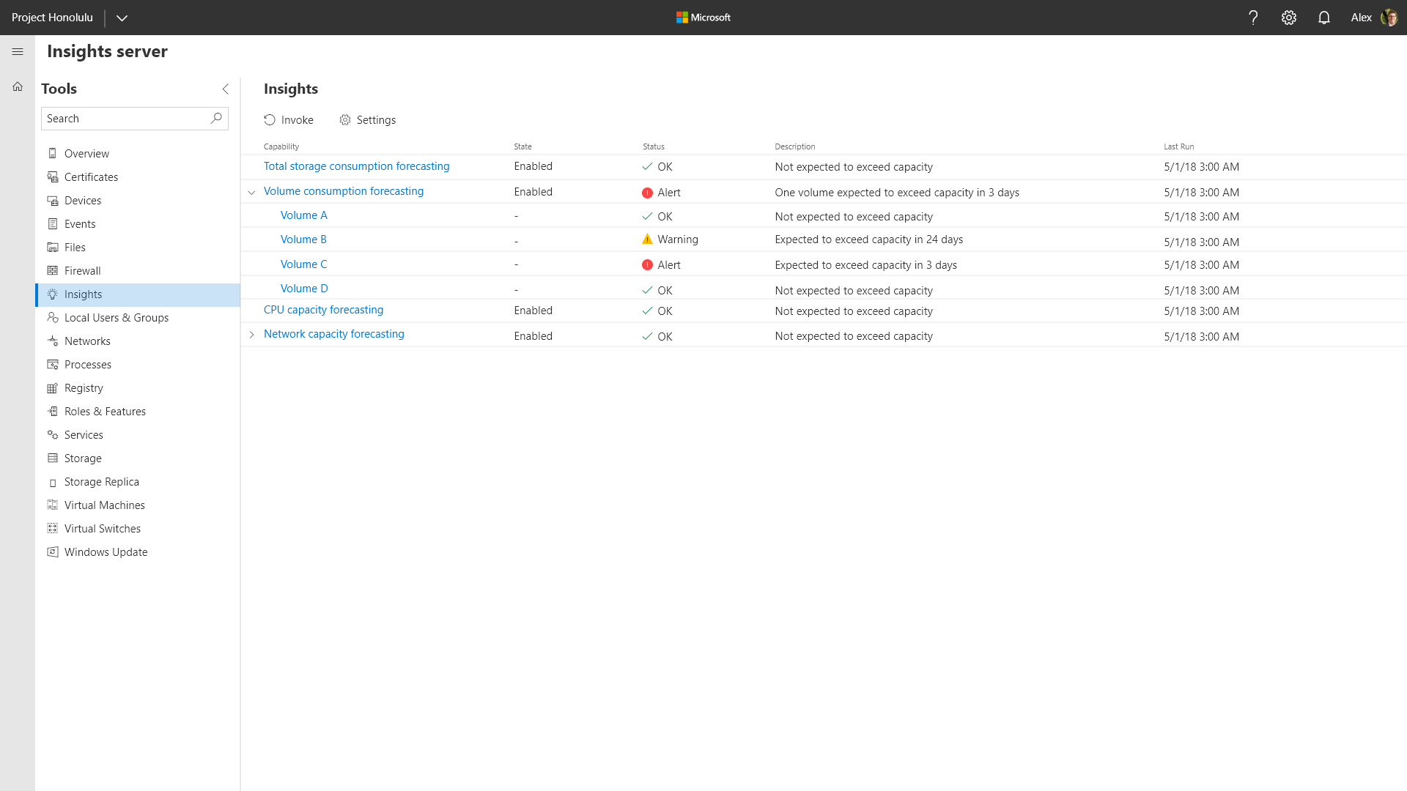
Demo
Windows Server 2019
System Insights
HBS PARTNERSHIP
CONFIDENTIAL. © 2016 HEARTLAND BUSINESS SYSTEMS
HBS.net
Notes:
Here we have a server with a number of volumes on it. We can see right on the insights view that we have some drives that we need to look at

Slide 36
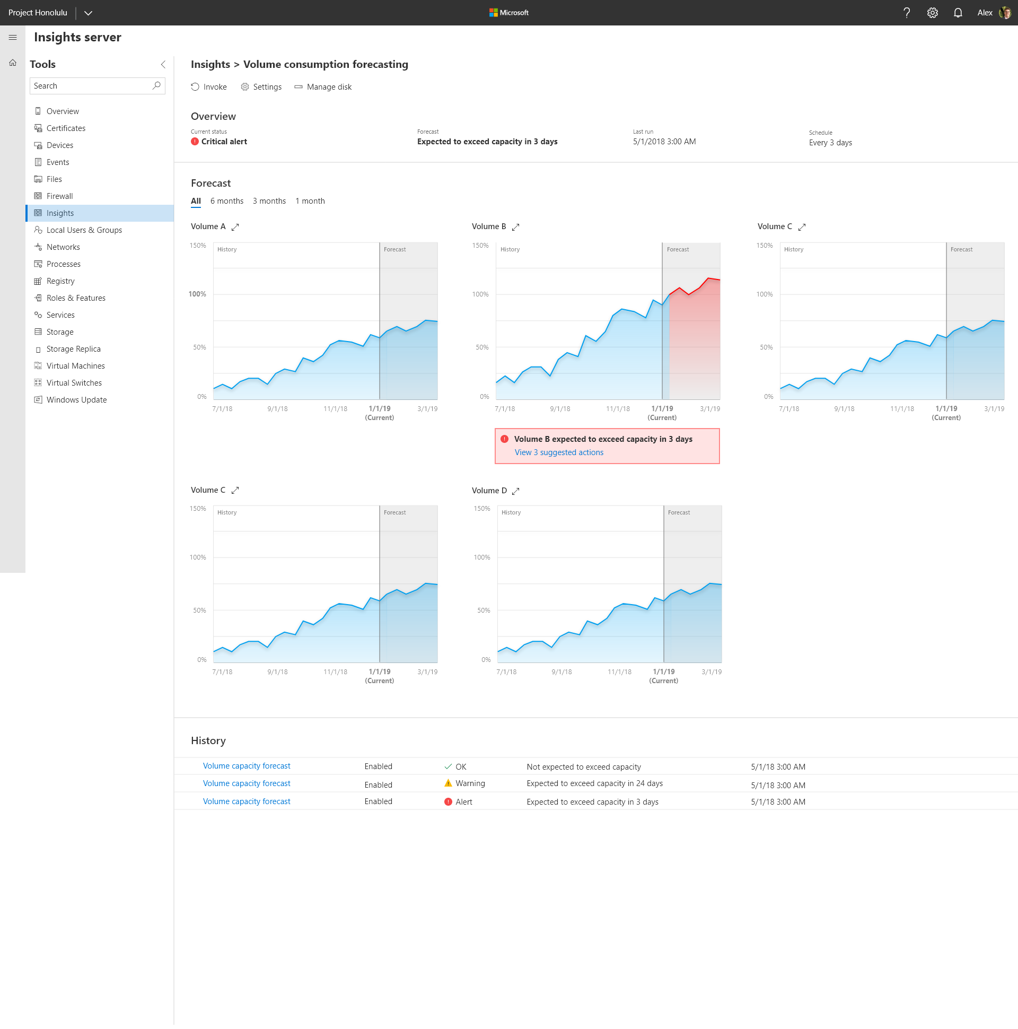
Demo
Windows Server 2019
System Insights
HBS PARTNERSHIP
CONFIDENTIAL. © 2016 HEARTLAND BUSINESS SYSTEMS
HBS.net
Notes:
The straight grey line is where I am right now. To the left I see my usage history, and to the right is where I’m forecasted to go if my usage trends continue
A looks fine, C looks great, but B is about to have a bad day.
How much of our admin time today is spent putting out fires. IT Infrastructure is invisible when it’s working properly, but when things go wrong people seem to notice very quickly
Insights is a tool designed to let you start becoming more proactive on support. It’s always better to address preventable outages before they can occur

Slide 37
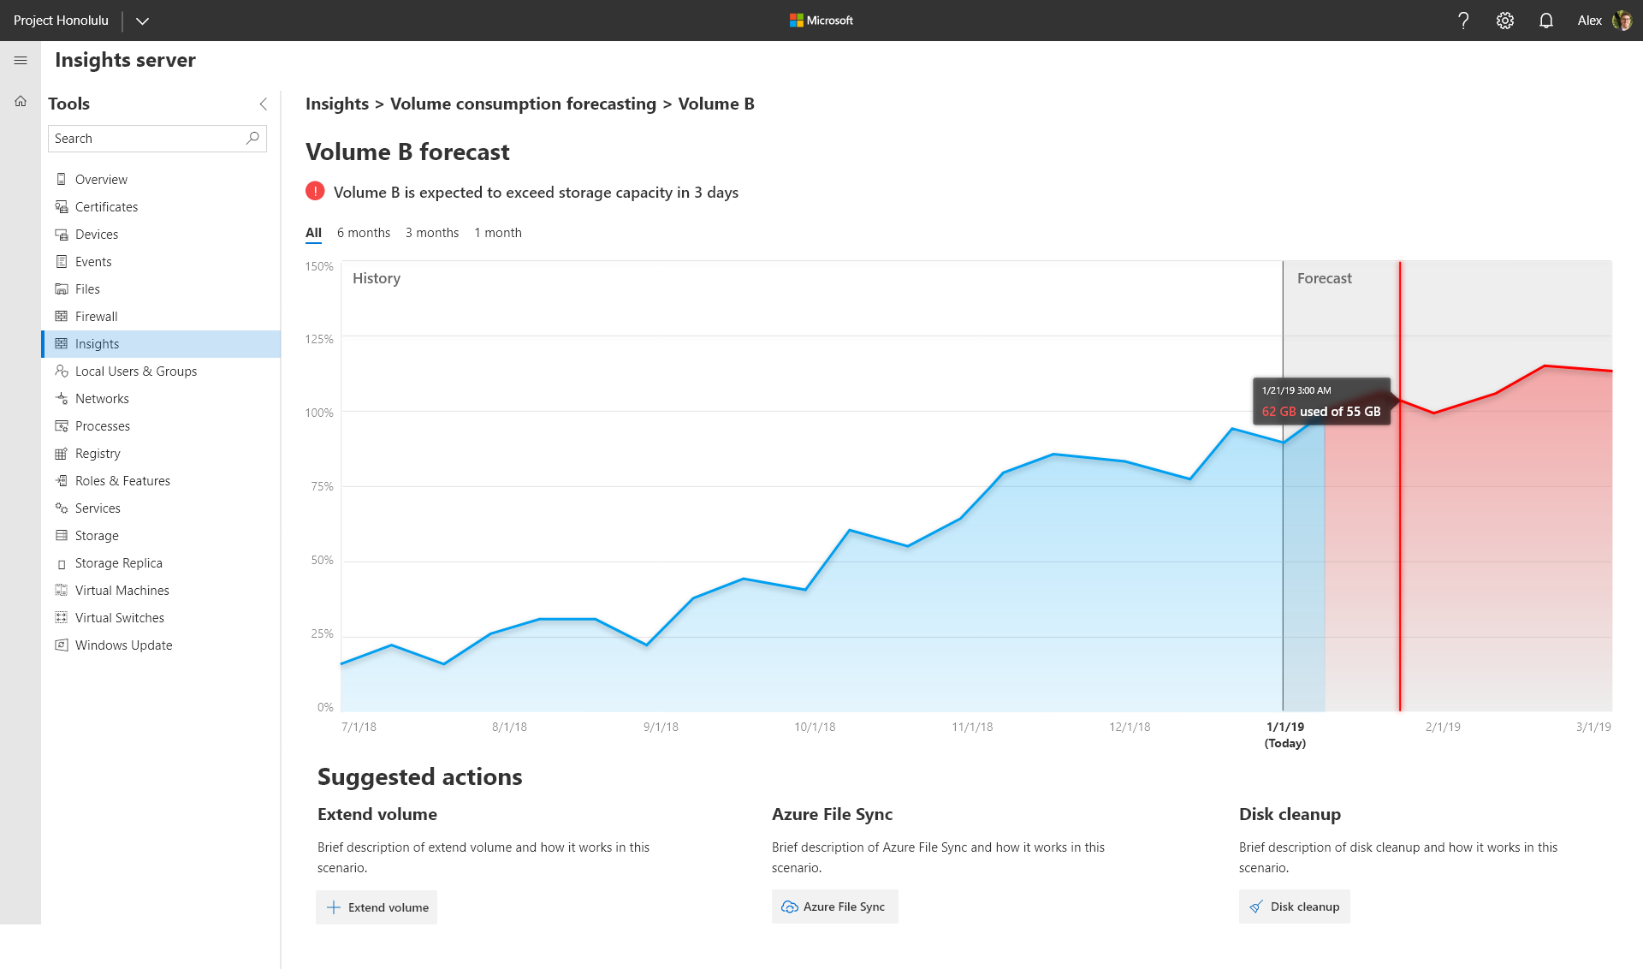
Demo
Windows Server 2019
System Insights
HBS PARTNERSHIP
CONFIDENTIAL. © 2016 HEARTLAND BUSINESS SYSTEMS
HBS.net
Notes:
If I click on it and drill down further, you’ll notice at the bottom Insights will give you suggested actions
If you have the ability you can extend the volume, 2) I can tier up some of those older files up to azure or 3) I can run disk cleanup.
Depending on how much temp data I have that may fix things for me short term, and gives me time to dig in for a longer term solution.
Insights lets you take your existing infrastructure and run predictive analytics on it.

Slide 38
Storage Migration Service
Windows Server 2019
File Server migrations are painful and hard.
All data must transfer
All shares and their configuration and file system security must transfer
All in-use files must transfer
All files you, the operator, don’t have access to must transfer
All use of local groups and users must transfer
All data attributes, alternate data streams, encryption, compression, etc. must transfer
Legacy apps and scripts that access files on shares can be hard to identify and update
End users must be coached on where to find their migrated data
Storage Migration Service
HBS PARTNERSHIP
CONFIDENTIAL. © 2016 HEARTLAND BUSINESS SYSTEMS
HBS.net
Notes:
Big idea number 2
This is a game changer
SSI migration story. First real enterprise infra project remote sites went well. Final Corp IT move – fat fingered robocopy mir command
Finance team FTP bank transaction stopped working
Years later moved to DFS PM, multiple people almost 200 hours worth of work
All would have been moot with Storage migration service

Slide 39
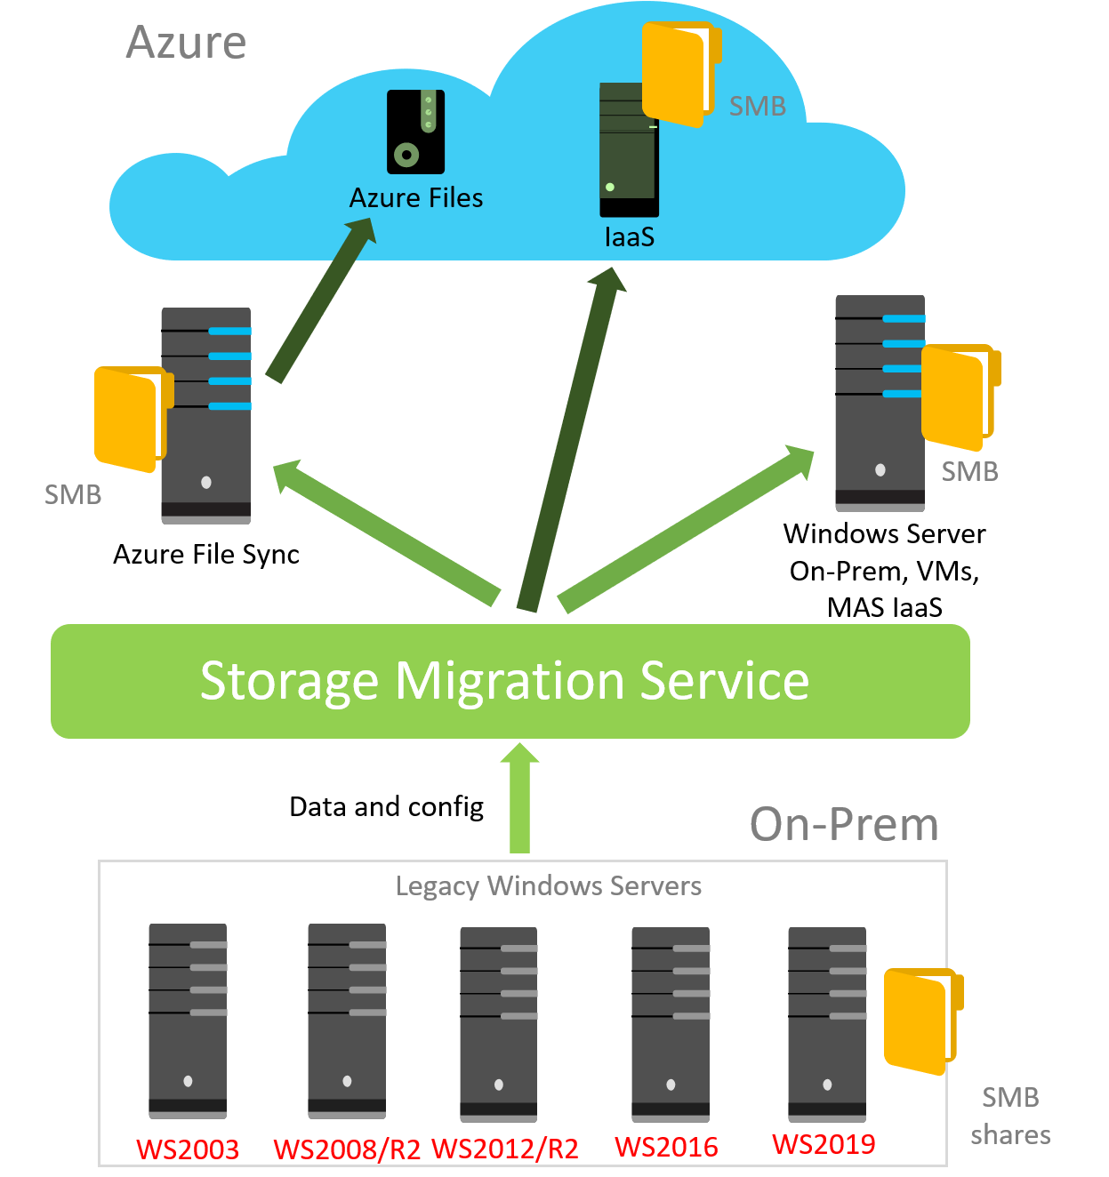
Storage Migration Service
Windows Server 2019
Migrates unstructured data from anywhere into Azure & modern Windows Servers
Fast, consistent, and scalable
Provides an elegant, graphical workflow…
Storage Migration Service
HBS PARTNERSHIP
CONFIDENTIAL. © 2016 HEARTLAND BUSINESS SYSTEMS
HBS.net
Notes:
Here is my centralized view… All of my servers are compliant. I can also use the schedule update button at the top left to schedule updates across all of my servers.

Slide 40
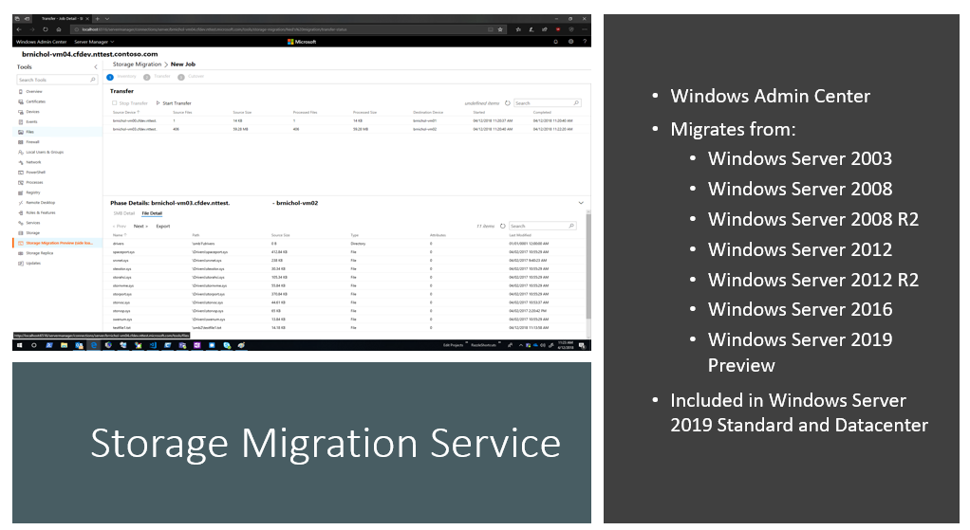
Storage Migration Service
Windows Server 2019
Storage Migration Service
HBS PARTNERSHIP
CONFIDENTIAL. © 2016 HEARTLAND BUSINESS SYSTEMS
HBS.net
Notes:
Double the speed when moving to server 2019 targets can also be 2016

Slide 41
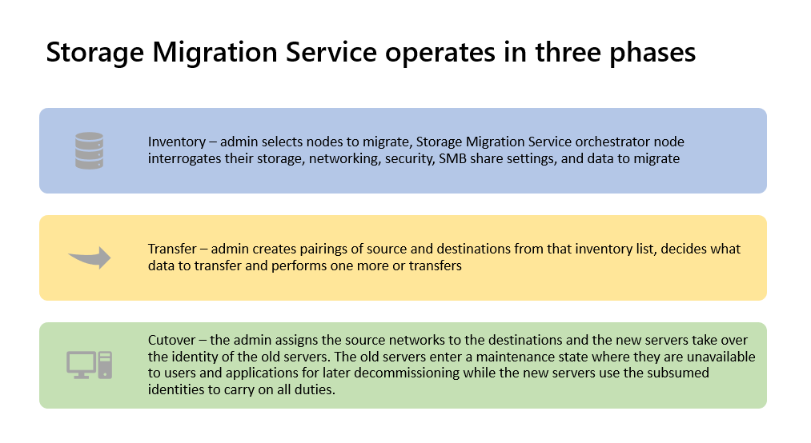
Windows Server 2019
Storage Migration Service
HBS PARTNERSHIP
CONFIDENTIAL. © 2016 HEARTLAND BUSINESS SYSTEMS
HBS.net
Notes:
Lets see what it looks lke

Slide 42
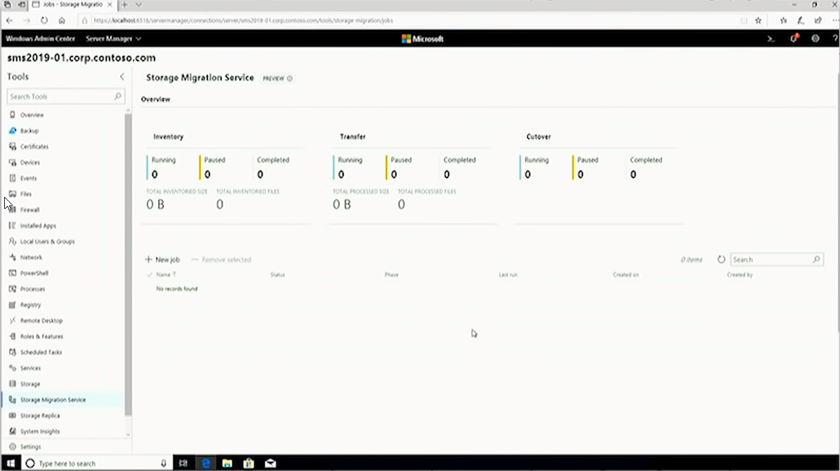
Demo
Windows Server 2019
Storage Migration Service
HBS PARTNERSHIP
CONFIDENTIAL. © 2016 HEARTLAND BUSINESS SYSTEMS
HBS.net
Notes:
This is our storage migration services dashboard in WAC
We’ll click on new job to get started

Slide 43
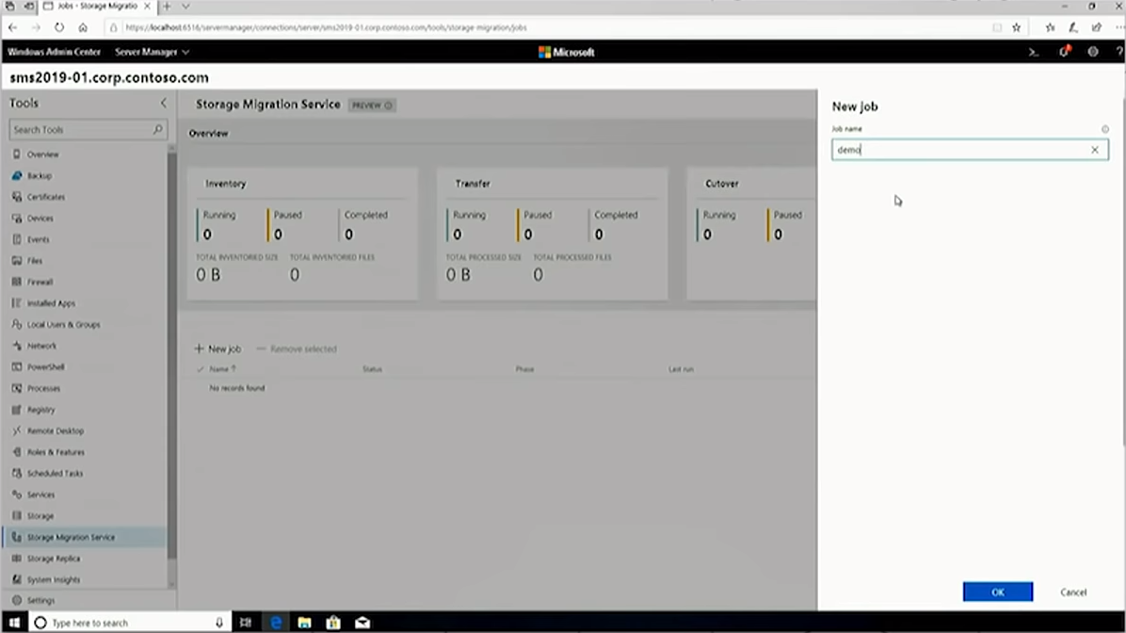
Demo
Windows Server 2019
Storage Migration Service
HBS PARTNERSHIP
CONFIDENTIAL. © 2016 HEARTLAND BUSINESS SYSTEMS
HBS.net
Notes:
Lets give our migration job a name, in this case demo

Slide 44
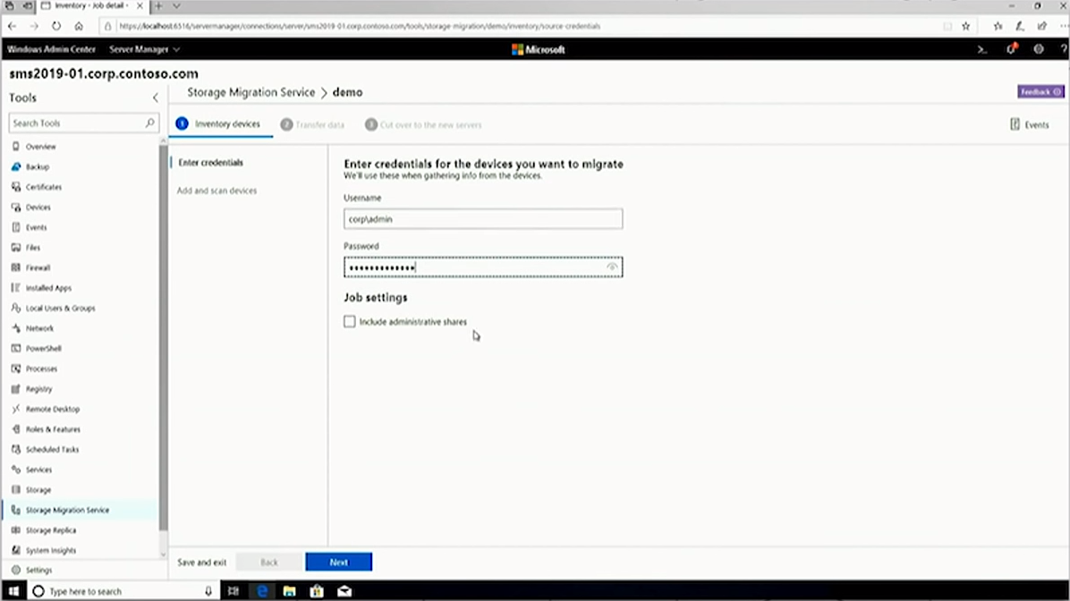
Demo
Windows Server 2019
Storage Migration Service
HBS PARTNERSHIP
CONFIDENTIAL. © 2016 HEARTLAND BUSINESS SYSTEMS
HBS.net
Notes:
Now I’m going to enter my admin credentials for migration

Slide 45
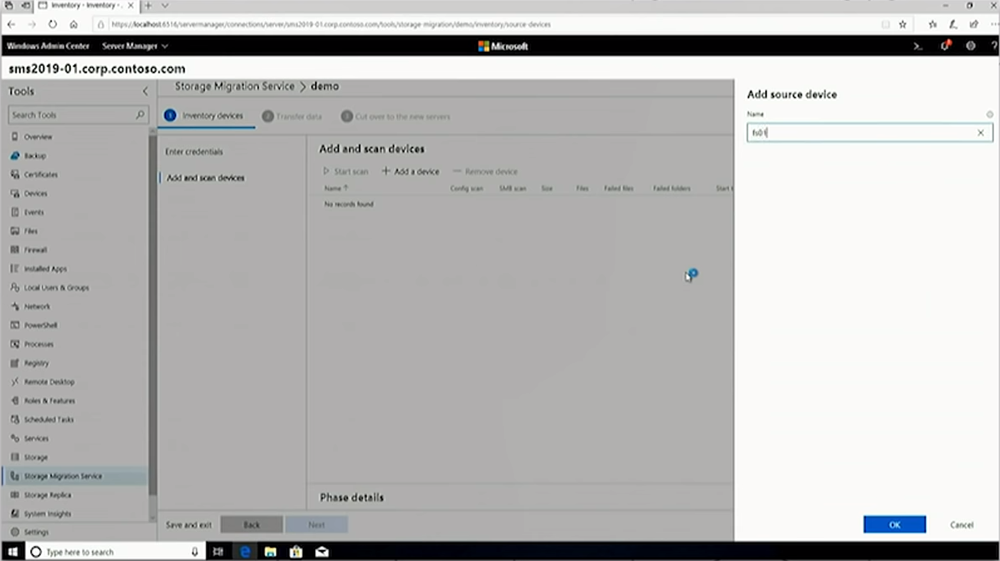
Demo
Windows Server 2019
Storage Migration Service
HBS PARTNERSHIP
CONFIDENTIAL. © 2016 HEARTLAND BUSINESS SYSTEMS
HBS.net
Notes:
Lets add a 2008 file server, FS1

Slide 46
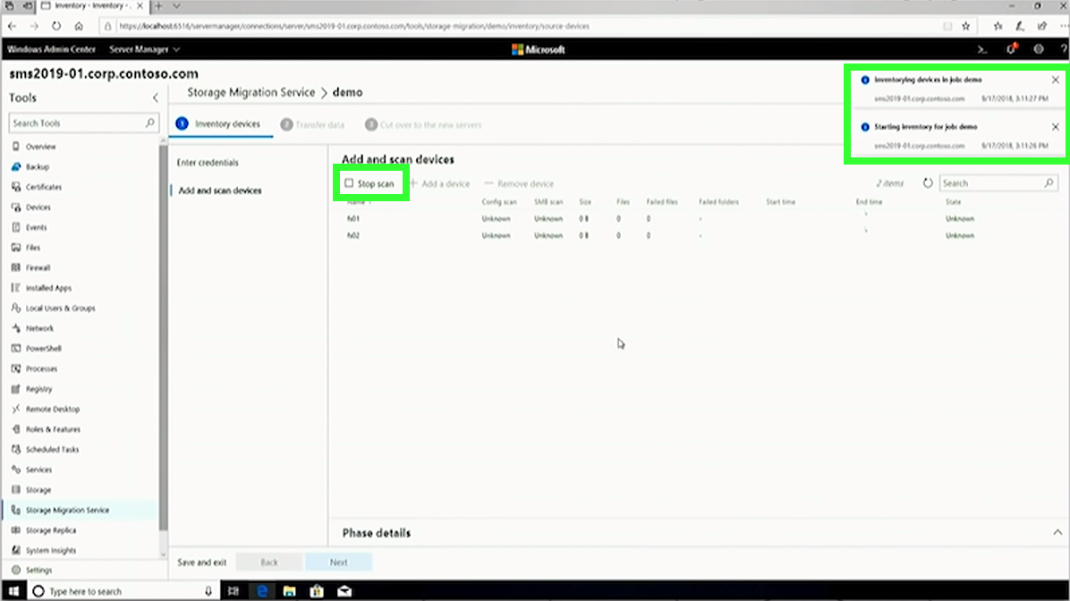
Demo
Windows Server 2019
Storage Migration Service
HBS PARTNERSHIP
CONFIDENTIAL. © 2016 HEARTLAND BUSINESS SYSTEMS
HBS.net
Notes:
Just for kicks I’ve added a second 2012 server as well FS2. I’m going to hit start scan to kick off the discovery process

Slide 47
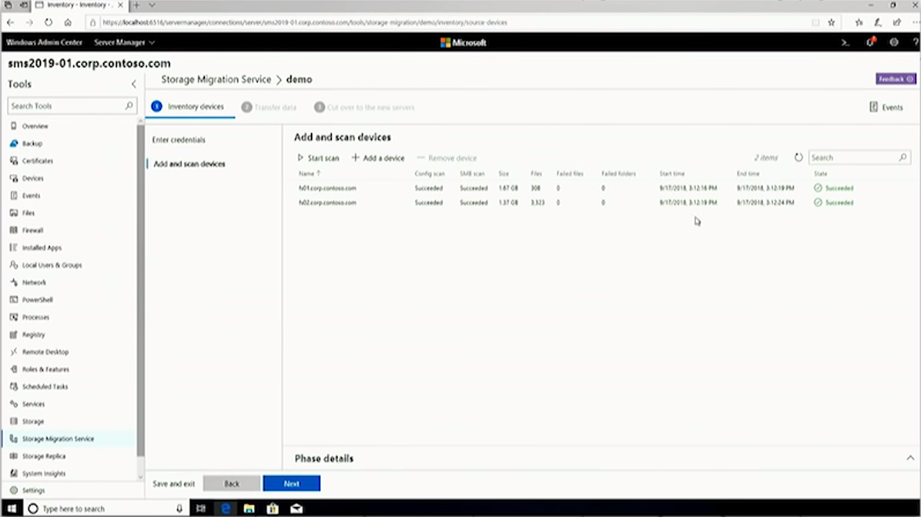
Demo
Windows Server 2019
Storage Migration Service
HBS PARTNERSHIP
CONFIDENTIAL. © 2016 HEARTLAND BUSINESS SYSTEMS
HBS.net
Notes:
The scans on both servers have completed, I can click on them to view the discovered details

Slide 48
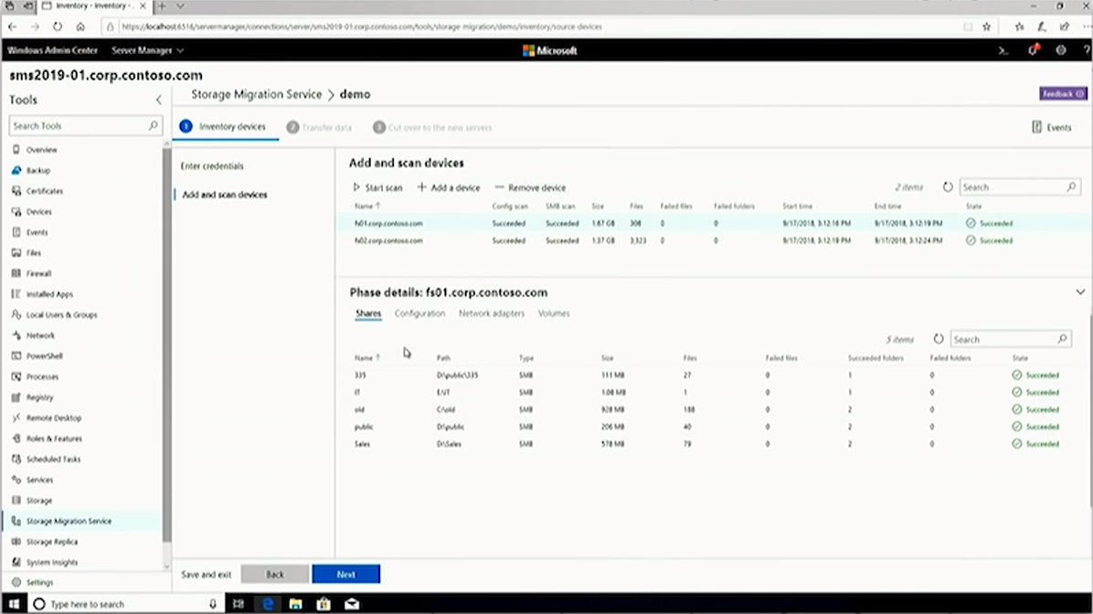
Demo
Windows Server 2019
Storage Migration Service
HBS PARTNERSHIP
CONFIDENTIAL. © 2016 HEARTLAND BUSINESS SYSTEMS
HBS.net
Notes:
ON FS1 I can see all of the shares, along with the share type, size, and number of files

Slide 49
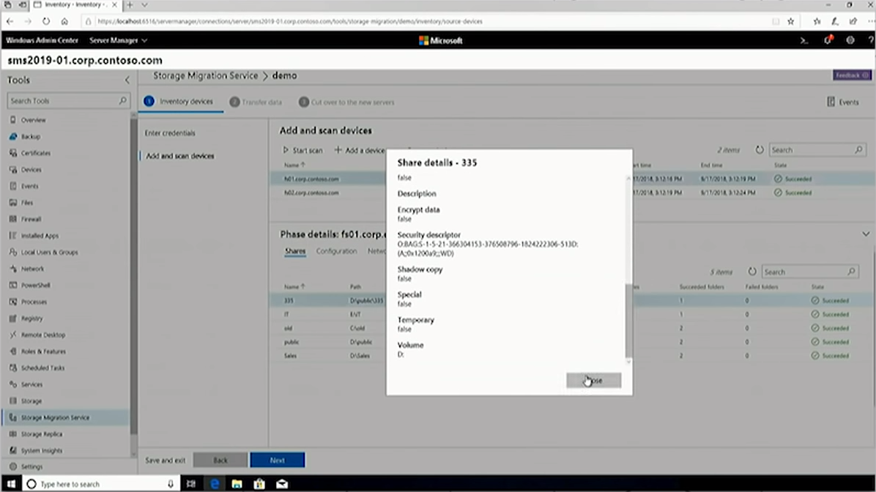
Demo
Windows Server 2019
Storage Migration Service
HBS PARTNERSHIP
CONFIDENTIAL. © 2016 HEARTLAND BUSINESS SYSTEMS
HBS.net
Notes:
I can even click on share to drill down deeper and see full properties, like shadow copy status, file encryption, volume drive info, and all other relevant info

Slide 50
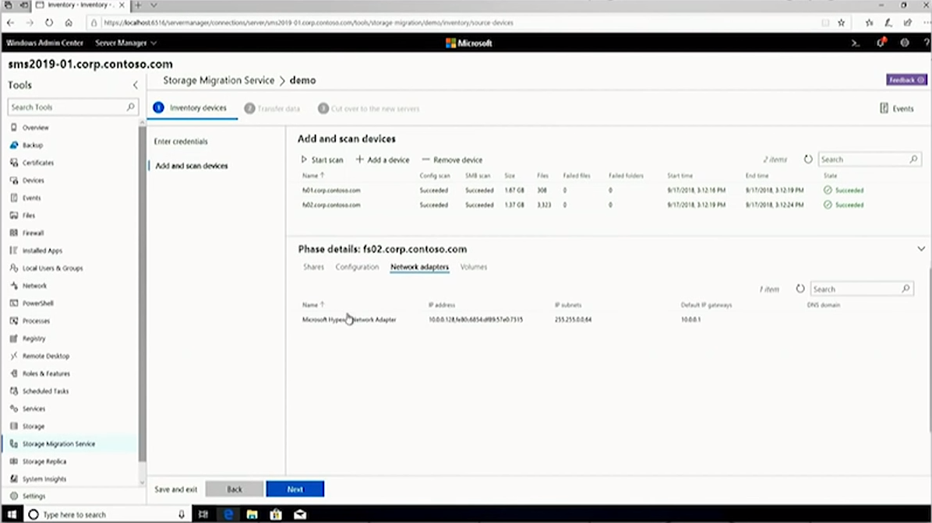
Demo
Windows Server 2019
Storage Migration Service
HBS PARTNERSHIP
CONFIDENTIAL. © 2016 HEARTLAND BUSINESS SYSTEMS
HBS.net
Notes:
Clicking FS2 we can look at the NIC configuration, I can also pull up configuration and volume info as well.

Slide 51
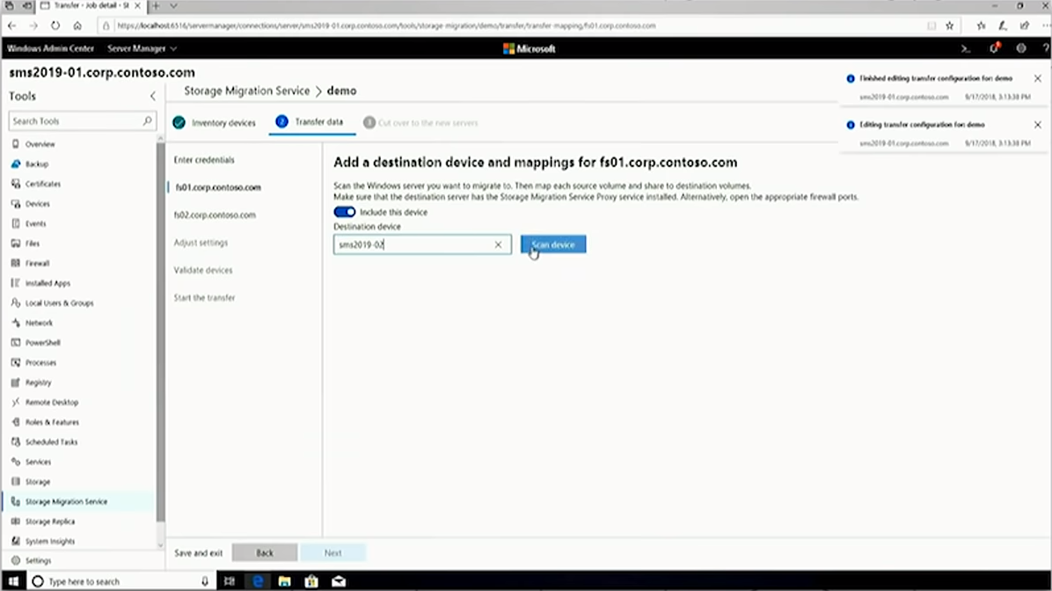
Demo
Windows Server 2019
Storage Migration Service
HBS PARTNERSHIP
CONFIDENTIAL. © 2016 HEARTLAND BUSINESS SYSTEMS
HBS.net
Notes:
Once we’ve reviewed our discovery data, we can add our destitution server for fs01. In this case sms2019-02

Slide 52
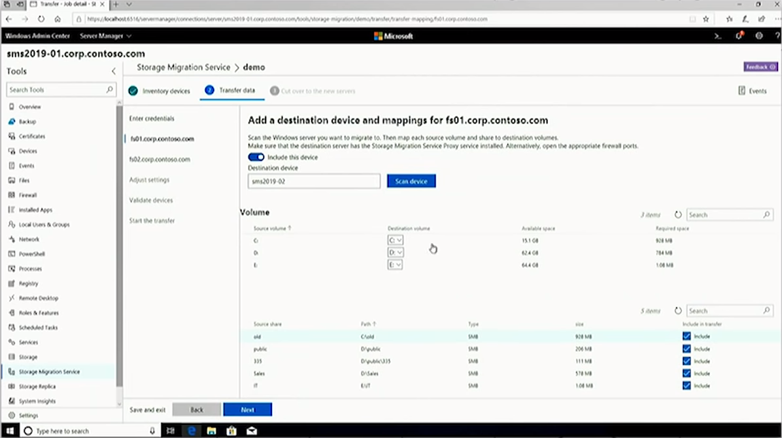
Demo
Windows Server 2019
Storage Migration Service
HBS PARTNERSHIP
CONFIDENTIAL. © 2016 HEARTLAND BUSINESS SYSTEMS
HBS.net
Notes:
The destination server will also scan to validate that I have the proper volumes and storage capacity for migration. The shares from the target server will automap to the destination.
If there are shares I do not wish to migrate, I can uncheck the box at the bottom and leave those behind.

Slide 53
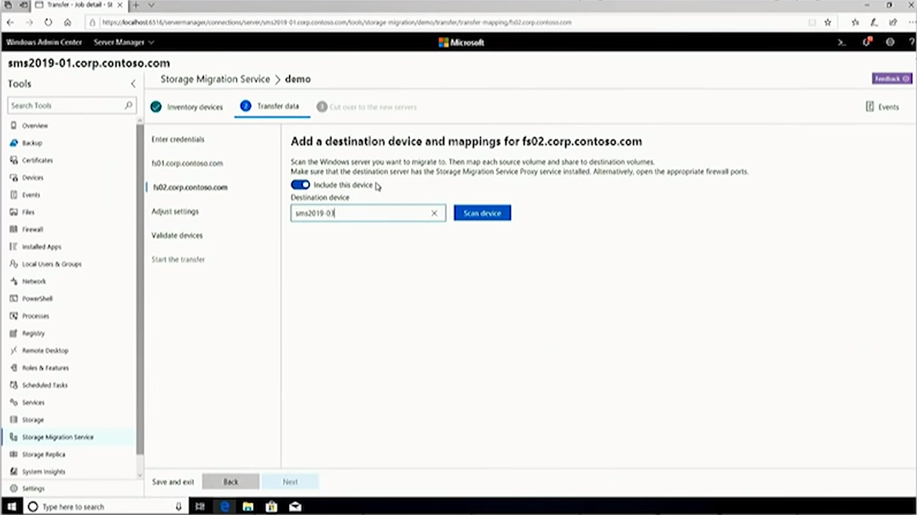
Demo
Windows Server 2019
Storage Migration Service
HBS PARTNERSHIP
CONFIDENTIAL. © 2016 HEARTLAND BUSINESS SYSTEMS
HBS.net
Notes:
Now we add our destination server for FS02.. Another 2019 server sms2019-03

Slide 54
Demo
Windows Server 2019
Storage Migration Service
HBS PARTNERSHIP
CONFIDENTIAL. © 2016 HEARTLAND BUSINESS SYSTEMS
HBS.net
Notes:
Again, the destination server is validated, and the shares automap to the new server

Slide 55
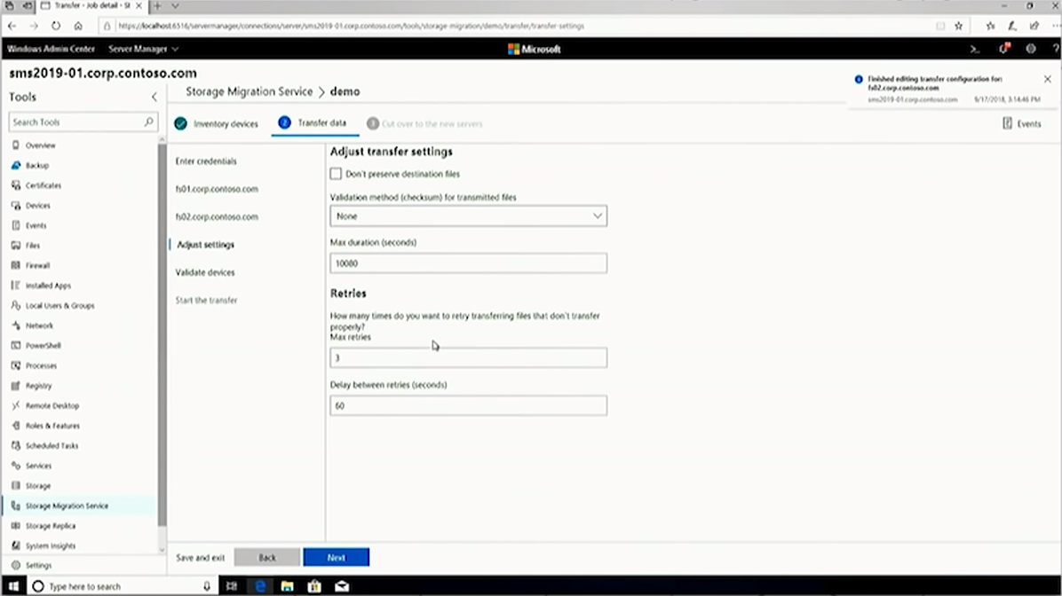
Demo
Windows Server 2019
Storage Migration Service
HBS PARTNERSHIP
CONFIDENTIAL. © 2016 HEARTLAND BUSINESS SYSTEMS
HBS.net
Notes:
Now I can prepare my file transfer by choosing if I want to checksum each transferred file for verification, I can also set a max duration and retry numbers

Slide 56
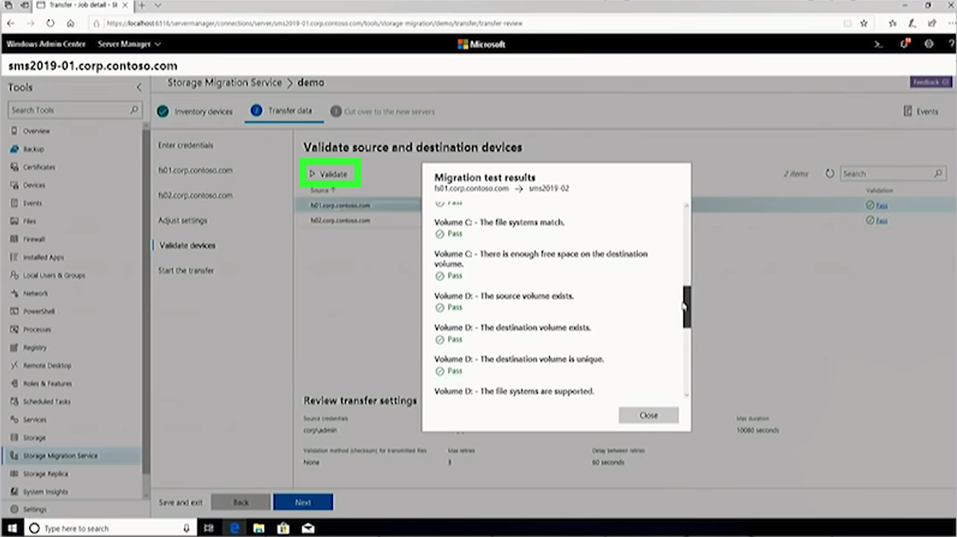
Demo
Windows Server 2019
Storage Migration Service
HBS PARTNERSHIP
CONFIDENTIAL. © 2016 HEARTLAND BUSINESS SYSTEMS
HBS.net
Notes:
Storage migration validates each step of the process. Before transferring our data we run another validation to check to make sure both target and destination servers can tak to each other, that the volumes are mounted correctly, and that the file systems are healthy and supported. I can drill down on both validation results to see detailed information

Slide 57
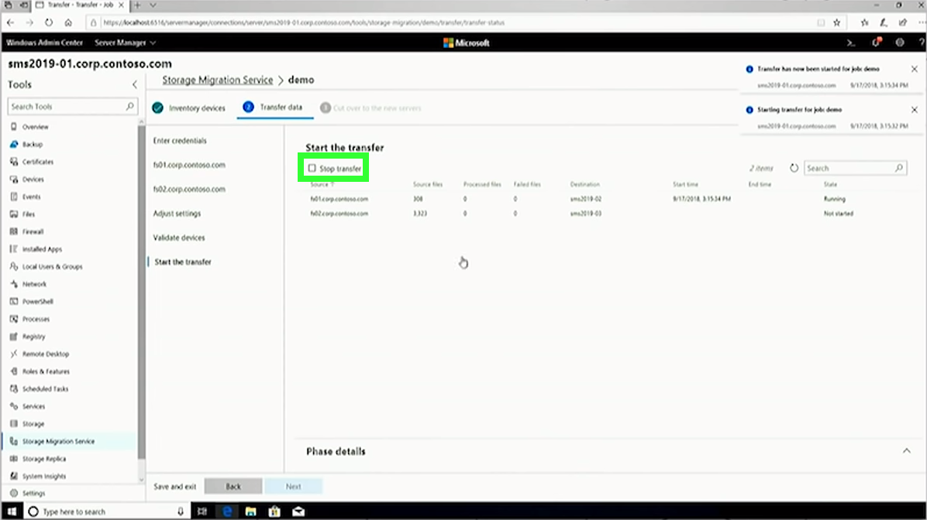
Demo
Windows Server 2019
Storage Migration Service
HBS PARTNERSHIP
CONFIDENTIAL. © 2016 HEARTLAND BUSINESS SYSTEMS
HBS.net
Notes:
Once all of our validations look good, we’re ready tos tart transferring data.

Slide 58
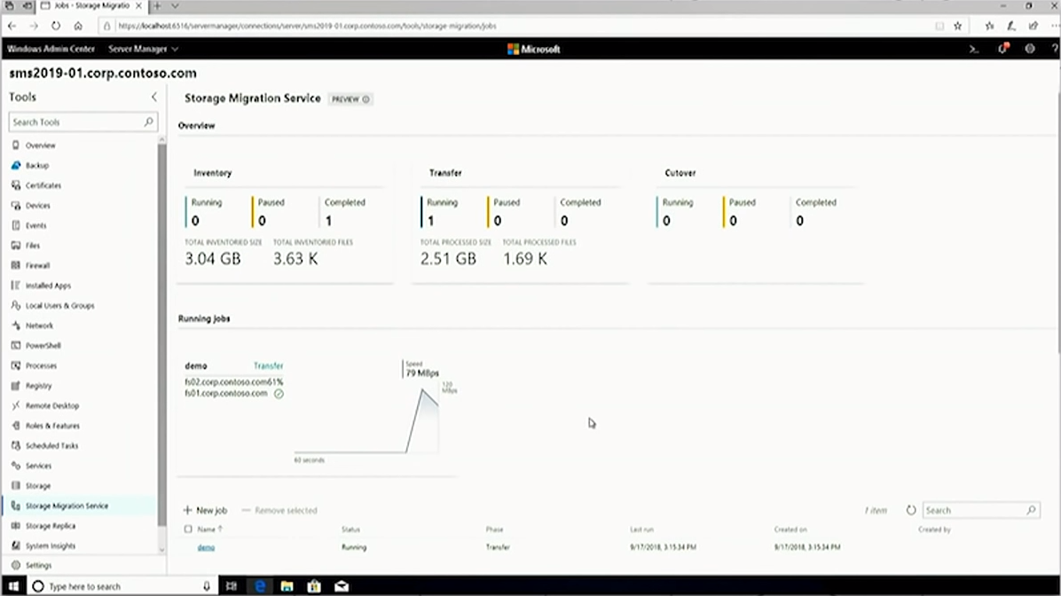
Demo
Windows Server 2019
Storage Migration Service
HBS PARTNERSHIP
CONFIDENTIAL. © 2016 HEARTLAND BUSINESS SYSTEMS
HBS.net
Notes:
Back on the dashboard we can see the status of our running jobs, along with the speed at which files are copying.

Slide 59
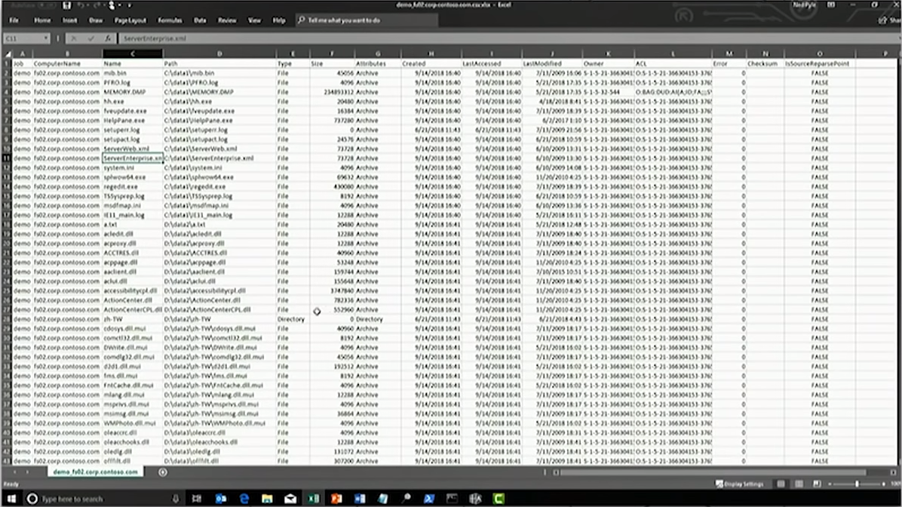
Demo
Windows Server 2019
Storage Migration Service
HBS PARTNERSHIP
CONFIDENTIAL. © 2016 HEARTLAND BUSINESS SYSTEMS
HBS.net
Notes:
Once the transfer has completed, I can even download a CSV containing information on each and every file copied. I see the name of every file, it’s apth, size, attributes for each file, last accessed time
Owner, ACLS.. Full details on each and every file on the server. This a great report to give you leader when they ask how are you sure you got all of the data transferred.

Slide 60
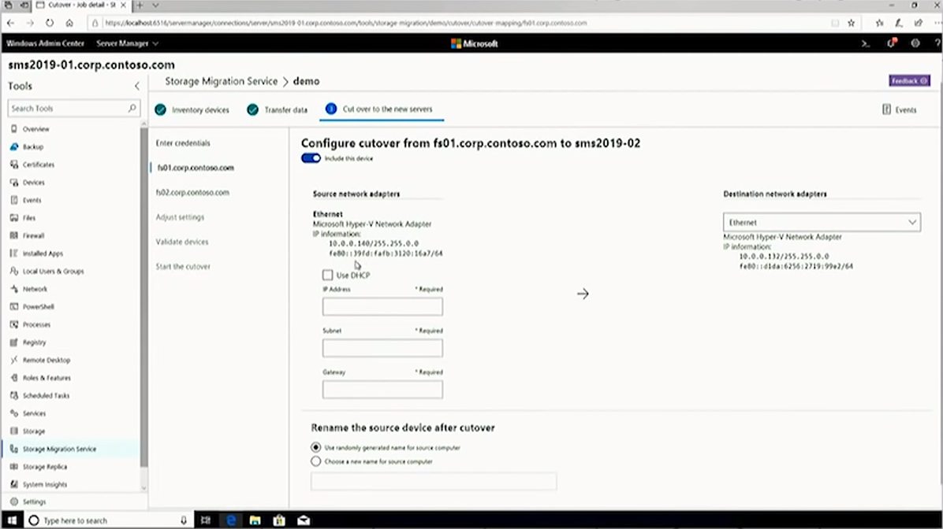
Demo
Windows Server 2019
Storage Migration Service
HBS PARTNERSHIP
CONFIDENTIAL. © 2016 HEARTLAND BUSINESS SYSTEMS
HBS.net
Notes:
Finally once our migration job has completed, we're ready for cutover. This is where the new server takes over the identity and network settings of the old server.
It prompts us to give the old server a new or randomly generated name, along with a static of DHCP IP address so it can be accessed by your administrators later for decom.
The data on the old servers still exists, we’re not changing or deleting the data.

Slide 61
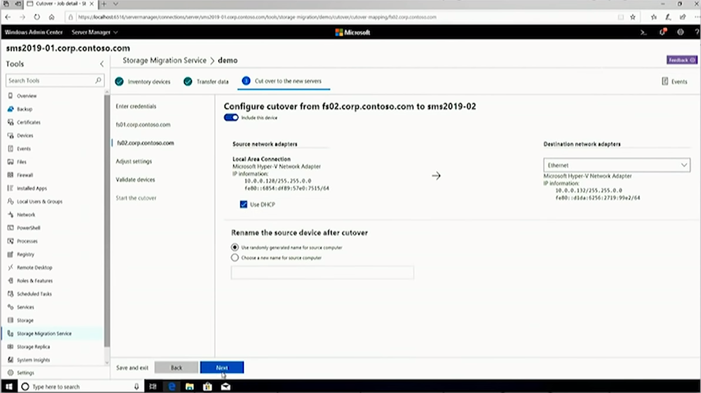
Demo
Windows Server 2019
Storage Migration Service
HBS PARTNERSHIP
CONFIDENTIAL. © 2016 HEARTLAND BUSINESS SYSTEMS
HBS.net
Notes:
We’ll do the same thing for fs2

Slide 62
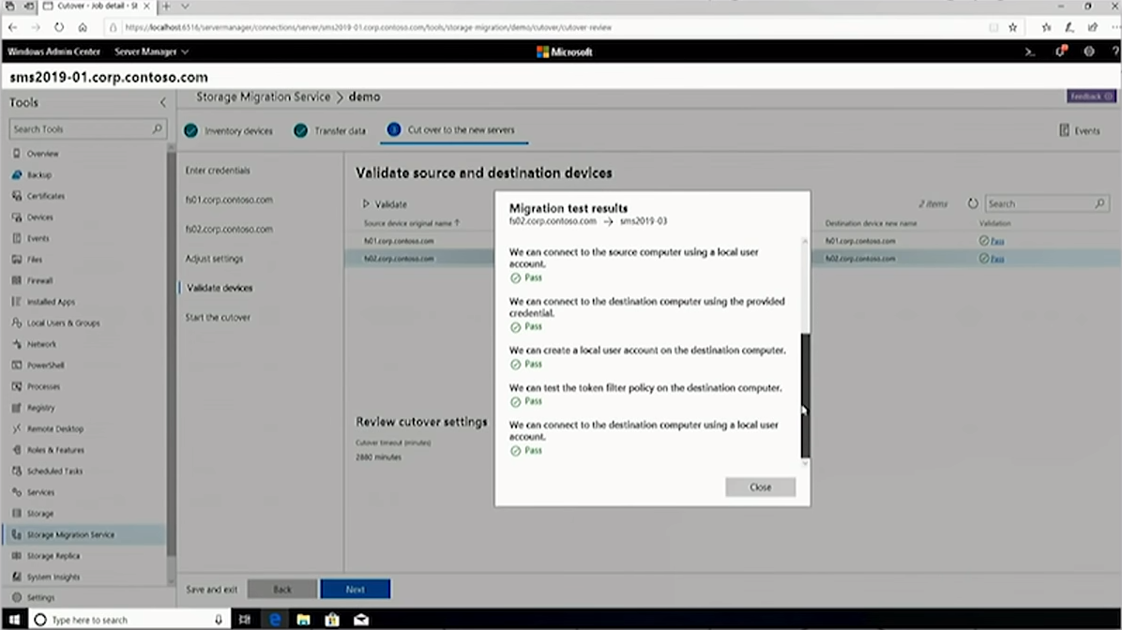
Demo
Windows Server 2019
Storage Migration Service
HBS PARTNERSHIP
CONFIDENTIAL. © 2016 HEARTLAND BUSINESS SYSTEMS
HBS.net
Notes:
Again we validate precut over to make sure that everything is going to go as planned.

Slide 63
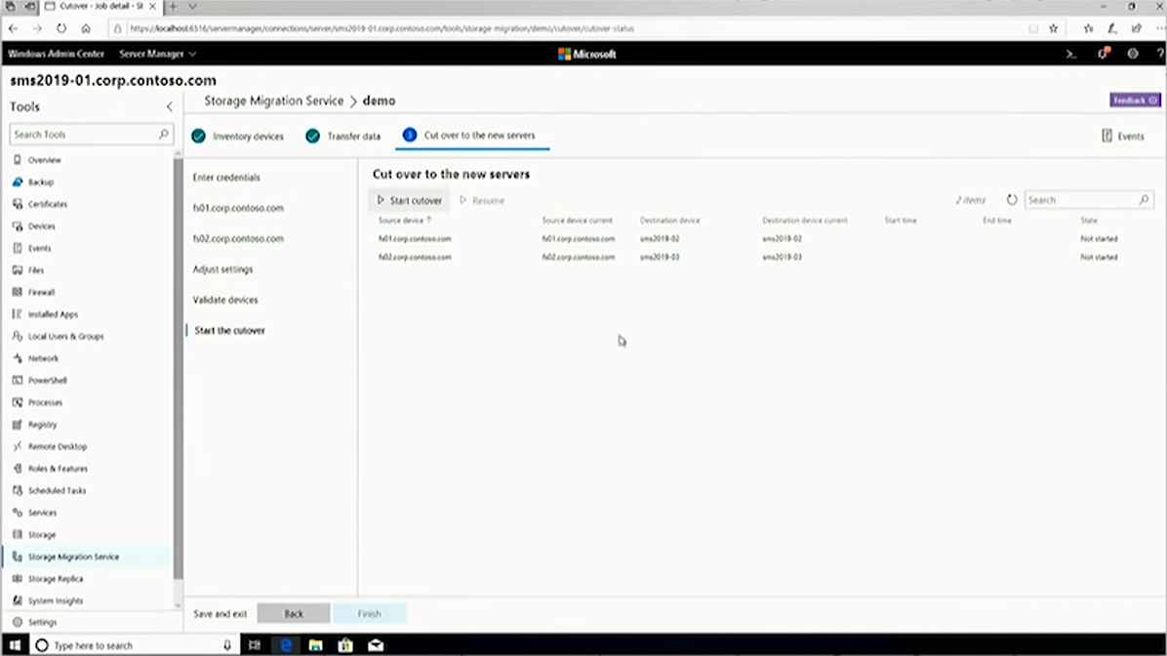
Demo
Windows Server 2019
Storage Migration Service
HBS PARTNERSHIP
CONFIDENTIAL. © 2016 HEARTLAND BUSINESS SYSTEMS
HBS.net
Notes:
We can now start the cutover process and watch it’s status as it completes.

Slide 64
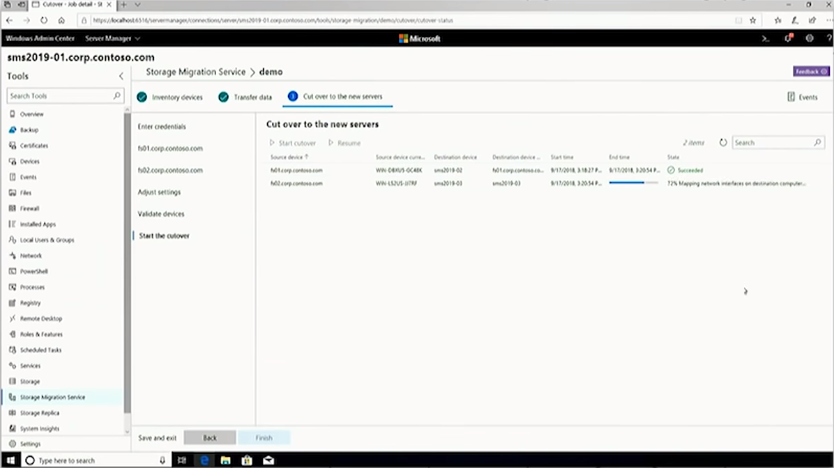
Demo
Windows Server 2019
Storage Migration Service
HBS PARTNERSHIP
CONFIDENTIAL. © 2016 HEARTLAND BUSINESS SYSTEMS
HBS.net
Notes:
The first server is done, we’re just waiting on fs02

Slide 65
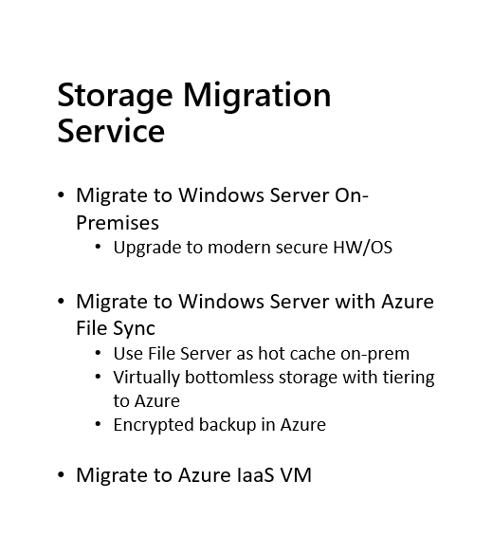
Windows Server 2019
Storage Migration Service
HBS PARTNERSHIP
CONFIDENTIAL. © 2016 HEARTLAND BUSINESS SYSTEMS
HBS.net
Notes:
We move migrate to server 2016 or 2019 on prem
Or Azure files in the cloud
When migrating to 2016 Windows amdin center running on 2019 is still required as an orchestration server. It can run on a destination target.

Slide 66
Windows Server 2019
Storage
HBS PARTNERSHIP
CONFIDENTIAL. © 2016 HEARTLAND BUSINESS SYSTEMS
HBS.net

Slide 67
Windows Server 2019
Clusters
HBS PARTNERSHIP
CONFIDENTIAL. © 2016 HEARTLAND BUSINESS SYSTEMS
HBS.net

Slide 68
Windows Server 2019
Software Defined Networking
HBS PARTNERSHIP
CONFIDENTIAL. © 2016 HEARTLAND BUSINESS SYSTEMS
HBS.net

Slide 69
SDN in Windows Admin Center
Windows Server 2019
Software Defined Networking
HBS PARTNERSHIP
CONFIDENTIAL. © 2016 HEARTLAND BUSINESS SYSTEMS
HBS.net
Notes:
With HCI Microsoft made a ton of improvements in 2016. Many of those like SDN required pwoershell and advanced knowledge to set up and configure.
Now the same work can be done in a few clicks in Windows Admin Center

Slide 70
Security
Windows Server 2019
Security
HBS PARTNERSHIP
CONFIDENTIAL. © 2016 HEARTLAND BUSINESS SYSTEMS
HBS.net

Slide 71
Advanced Threat Protection
Windows Server 2019
Security
Microsoft has continued to include built-in security functionality to help organizations address an “expect breach” model of security management. Rather than assuming firewalls along the perimeter of an enterprise will prevent any and all security compromises, Windows Server 2019 assumes servers and applications within the core of a datacenter have already been compromised.
HBS PARTNERSHIP
CONFIDENTIAL. © 2016 HEARTLAND BUSINESS SYSTEMS
HBS.net

Slide 72
Advanced Threat Protection
Windows Server 2019
Security
Next Gen AV
Attack surface reduction
Auto investigation and remediation
File behavior monitoring
Advanced hunting and queries to narrow down suspicious activity.
Secure Score integration
Other additional security features.
HBS PARTNERSHIP
CONFIDENTIAL. © 2016 HEARTLAND BUSINESS SYSTEMS
HBS.net
Notes:
ATP is included in server 2019

Slide 73
Hybrid Security
Windows Server 2019
Security
Password protection for Windows Server Active Directory
HBS PARTNERSHIP
CONFIDENTIAL. © 2016 HEARTLAND BUSINESS SYSTEMS
HBS.net

Slide 74
Windows Server 2019
Banned Passwords
HBS PARTNERSHIP
CONFIDENTIAL. © 2016 HEARTLAND BUSINESS SYSTEMS
HBS.net
Notes:
Windows Hello for Business, MFA, these are great tools, but many orgs still have legacy apps that require FBA that authenticate against Windows AD
Password less isn’t always an option

Slide 75
Windows Server 2019
Banned Passwords
HBS PARTNERSHIP
CONFIDENTIAL. © 2016 HEARTLAND BUSINESS SYSTEMS
HBS.net
Notes:
All the work MS has put into requiring strong passwords in Azure/365 can now be leveraged on prem.
There’s a lot of advanced AI behind this that’s not easy to run on prem.
We will leverage password filters on our DCs to pass new passwords up to Azure for inspection before each and every password change
Lert’s see it in action

Slide 76
Demo
Windows Server 2019
Banned Passwords
HBS PARTNERSHIP
CONFIDENTIAL. © 2016 HEARTLAND BUSINESS SYSTEMS
HBS.net

Slide 77
Demo
Windows Server 2019
Banned Passwords
HBS PARTNERSHIP
CONFIDENTIAL. © 2016 HEARTLAND BUSINESS SYSTEMS
HBS.net
Notes:
We can set it to audit mode only for testing and reporting or full enforcement
We also add a custom word list with school names, mascots, any common words that are easily tied to your org.
There’s also a built in dictionary of bad passwords.

Slide 78
Demo
Windows Server 2019
Banned Passwords
HBS PARTNERSHIP
CONFIDENTIAL. © 2016 HEARTLAND BUSINESS SYSTEMS
HBS.net
Notes:
Once banned passwords are set up, it’s time to download the connector.
Since this is hybrid based, our DC’s need to talk to the cloud
How many of you are OK with your DC’s having a direct connection to the cloud?
No? Me either. That’s why there are two components
The password proxy sits on another non DC in your data center and acts as a relay point between on prem AD and Azure
The DC agent only contains the password filter itself and AD will the proxy server as a go-between to validate passwords

Slide 79
Demo
Windows Server 2019
Banned Passwords
HBS PARTNERSHIP
CONFIDENTIAL. © 2016 HEARTLAND BUSINESS SYSTEMS
HBS.net
Notes:
Once the proxy agent is installed, we need to run 2 commands to register it with Azure AD

Slide 80
Demo
Windows Server 2019
Banned Passwords
HBS PARTNERSHIP
CONFIDENTIAL. © 2016 HEARTLAND BUSINESS SYSTEMS
HBS.net
Notes:
Finally we install the password filter on all of our DCs
Let’s see what the end users will see, in the first case I’m going to try and change my AD password to Password1.

Slide 81
Demo
Windows Server 2019
Banned Passwords
HBS PARTNERSHIP
CONFIDENTIAL. © 2016 HEARTLAND BUSINESS SYSTEMS
HBS.net
Notes:
The built in bad password list blocks it

Slide 82
Demo
Windows Server 2019
Banned Passwords
HBS PARTNERSHIP
CONFIDENTIAL. © 2016 HEARTLAND BUSINESS SYSTEMS
HBS.net
Notes:
Now let’s try our company name. This was one of the entries we added to our custom list

Slide 83
Demo
Windows Server 2019
Banned Passwords
HBS PARTNERSHIP
CONFIDENTIAL. © 2016 HEARTLAND BUSINESS SYSTEMS
HBS.net
Notes:
Blocked again

Slide 84
Demo
Windows Server 2019
Banned Passwords
HBS PARTNERSHIP
CONFIDENTIAL. © 2016 HEARTLAND BUSINESS SYSTEMS
HBS.net
Notes:
Let’s try company name again, only this time I’ll swap the T for an underscore.

Slide 85
Demo
Windows Server 2019
Banned Passwords
HBS PARTNERSHIP
CONFIDENTIAL. © 2016 HEARTLAND BUSINESS SYSTEMS
HBS.net
Notes:
Nope

Slide 86
Demo
Windows Server 2019
Banned Passwords
HBS PARTNERSHIP
CONFIDENTIAL. © 2016 HEARTLAND BUSINESS SYSTEMS
HBS.net
Notes:
Here is my centralized view… All of my servers are compliant. I can also use the schedule update button at the left to schedule updates across all of my servers.

Slide 87
Demo
Windows Server 2019
Banned Passwords
HBS PARTNERSHIP
CONFIDENTIAL. © 2016 HEARTLAND BUSINESS SYSTEMS
HBS.net

Slide 88
Demo
Windows Server 2019
Banned Passwords
HBS PARTNERSHIP
CONFIDENTIAL. © 2016 HEARTLAND BUSINESS SYSTEMS
HBS.net
Notes:
Here is my centralized view… All of my servers are compliant. I can also use the schedule update button at the top left to schedule updates across all of my servers.

Slide 89
Demo
Windows Server 2019
Banned Passwords
HBS PARTNERSHIP
CONFIDENTIAL. © 2016 HEARTLAND BUSINESS SYSTEMS
HBS.net

Slide 90
Windows Server 2019
Banned Passwords
HBS PARTNERSHIP
CONFIDENTIAL. © 2016 HEARTLAND BUSINESS SYSTEMS
HBS.net

Slide 91
Application Innovations
Windows Server 2019
Applications
HBS PARTNERSHIP
CONFIDENTIAL. © 2016 HEARTLAND BUSINESS SYSTEMS
HBS.net
Notes:
Here is my centralized view… All of my servers are compliant. I can also use the schedule update button at the top left to schedule updates across all of my servers.

Slide 92
Application Innovations
Windows Server 2019
Applications
Windows Server 2019 Features on Demand
HBS PARTNERSHIP
CONFIDENTIAL. © 2016 HEARTLAND BUSINESS SYSTEMS
HBS.net
Notes:
Here is my centralized view… All of my servers are compliant. I can also use the schedule update button at the top left to schedule updates across all of my servers.

Slide 93
Features on Demand
Windows Server 2019
FOD
With the advent of Admin Center we are moving to Server Core
Challenges
Minimal local tools
Installers
HBS PARTNERSHIP
CONFIDENTIAL. © 2016 HEARTLAND BUSINESS SYSTEMS
HBS.net
Notes:
Managing Core was hard, especially for those wh aren’t 100% comfortable with powershell.
Now with WAC, RSAT, and PowerShell, Most of the reasons to log into a server can be done remotely with other tools.
There are still some app installers though that don’t play nice with server core.
Which brings us to Features on Demand

Slide 94
Features on Demand
Windows Server 2019
FOD
Intro to features on demand (FODs)
What is it? Server Core + additional (340 MB)
Where can I get it?
Today: Insiders or Collaborate
Windows Server 2019: VLSC, EvalCenter, WU
SC App Compatibility FOD – what’s it for?
Improved support for apps already in market
Improved support for debugging and tools
HBS PARTNERSHIP
CONFIDENTIAL. © 2016 HEARTLAND BUSINESS SYSTEMS
HBS.net
Notes:
FOD is contained is an ISO that can be downloaded whereever you get your server isntallers, VLC, Eval center etc

Slide 95
Features on Demand
Windows Server 2019
To install Server Core with FoD binaries
Download the FoD ISO.
Sign in as administrator on the newly installed preview release of Server Core.
Insert the ISO into your VM
Enter the following command: DISM /Online /Add-Capability /CapabilityName:ServerCore.Appcompatibility~~~~0.0.1.0 /Source:drive_letter_of_mounted_ISO: /LimitAccess
For example, if D is your virtual DVD drive, the command is: DISM /Online /Add-Capability /CapabilityName:ServerCore.Appcompatibility~~~~0.0.1.0 /Source:D: /LimitAccess
After the progress bar completes, restart the operating system at the prompt.
FOD
HBS PARTNERSHIP
CONFIDENTIAL. © 2016 HEARTLAND BUSINESS SYSTEMS
HBS.net

Slide 96
Demo
Windows Server 2019
FOD
HBS PARTNERSHIP
CONFIDENTIAL. © 2016 HEARTLAND BUSINESS SYSTEMS
HBS.net
Notes:
Before FOD is installed lets try to access some local debug and troubleshooting tools on the server

Slide 97
Demo
Windows Server 2019
FOD
HBS PARTNERSHIP
CONFIDENTIAL. © 2016 HEARTLAND BUSINESS SYSTEMS
HBS.net
Notes:
MMC? No go

Slide 98
Demo
Windows Server 2019
FOD
HBS PARTNERSHIP
CONFIDENTIAL. © 2016 HEARTLAND BUSINESS SYSTEMS
HBS.net
Notes:
What about eventviewer? Nope

Slide 99
Demo
Windows Server 2019
FOD
HBS PARTNERSHIP
CONFIDENTIAL. © 2016 HEARTLAND BUSINESS SYSTEMS
HBS.net
Notes:
Windows Explorer? You guessed it

Slide 100
Demo
Windows Server 2019
FOD
HBS PARTNERSHIP
CONFIDENTIAL. © 2016 HEARTLAND BUSINESS SYSTEMS
HBS.net
Notes:
Now lets add FOD. We run the DISM command from the previous slide

Slide 101
Demo
Windows Server 2019
FOD
HBS PARTNERSHIP
CONFIDENTIAL. © 2016 HEARTLAND BUSINESS SYSTEMS
HBS.net
Notes:
Here is my centralized view… All of my servers are compliant. I can also use the schedule update button at the top left to schedule updates across all of my servers.

Slide 102
Demo
Windows Server 2019
FOD
HBS PARTNERSHIP
CONFIDENTIAL. © 2016 HEARTLAND BUSINESS SYSTEMS
HBS.net
Notes:
And wait for it to compelte

Slide 103
Demo
Windows Server 2019
FOD
HBS PARTNERSHIP
CONFIDENTIAL. © 2016 HEARTLAND BUSINESS SYSTEMS
HBS.net
Notes:
Now we need to reboot for the changes to take affect

Slide 104
Demo
Windows Server 2019
FOD
HBS PARTNERSHIP
CONFIDENTIAL. © 2016 HEARTLAND BUSINESS SYSTEMS
HBS.net
Notes:
Once the server has come back up, you’ll notice that the window border on the login screen is blue.
This is to let us know that FOD is enabled. It will return to gray after login

Slide 105
Demo
Windows Server 2019
FOD
HBS PARTNERSHIP
CONFIDENTIAL. © 2016 HEARTLAND BUSINESS SYSTEMS
HBS.net
Notes:
Back to gray

Slide 106
Demo
Windows Server 2019
FOD
HBS PARTNERSHIP
CONFIDENTIAL. © 2016 HEARTLAND BUSINESS SYSTEMS
HBS.net
Notes:
Lets try MMC again

Slide 107
Demo
Windows Server 2019
FOD
HBS PARTNERSHIP
CONFIDENTIAL. © 2016 HEARTLAND BUSINESS SYSTEMS
HBS.net
Notes:
Eventviewer?

Slide 108
Demo
Windows Server 2019
FOD
HBS PARTNERSHIP
CONFIDENTIAL. © 2016 HEARTLAND BUSINESS SYSTEMS
HBS.net
Notes:
And file explorer they all work

Slide 109
Features on Demand
OS components
Microsoft Management Console (Mmc.exe)
Event Viewer (Eventvwr.msc)
Performance Monitor (PerfMon.exe)
Resource Monitor (Resmon.exe)
Device Manager (Devmgmt.msc)
File Explorer (Explorer.exe)
Windows PowerShell ISE (Powershell_ISE.exe)
Failover Cluster Manager (CluAdmin.msc)
Internet Explorer (IExplore.exe) - optional
Windows Server 2019
Apps
Exchange Server 2019
(Server Core Recommended. FOD not needed)
SQL DB Engine
((Server Core Recommended. FOD not needed)
SQL Server Management Studio
SQL 16, 17
TFS Server
More to come…
FOD
HBS PARTNERSHIP
CONFIDENTIAL. © 2016 HEARTLAND BUSINESS SYSTEMS
HBS.net
Notes:
Server core is now the base recommendation for Exchange 2019 and SQL

Slide 110
Features on Demand
Windows Server 2019
To optionally install Internet Explorer 11 (requires App Compatibility FOD)
Start PowerShell by entering powershell.exe at a command prompt.
Mount the FoD ISO by using the following command:
Mount-DiskImage -ImagePath drive_letter:\folder_where_ISO_is_saved
Enter exit to exit PowerShell.
In a command window, change the default directory to drive letter of the mounted ISO.
Enter the following command: DISM /online /add-package:"Microsoft-Windows-InternetExplorer-Optional-Package~31bf3856ad364e35~amd64~~.cab"
Restart the computer.
FOD
HBS PARTNERSHIP
CONFIDENTIAL. © 2016 HEARTLAND BUSINESS SYSTEMS
HBS.net
Notes:
IE support is not included by default but can be added with a separate ISO. This is for security reasons

Slide 111
Deployment Best Practices & Recommendations
Windows Server 2019
Best Practice: Start with Server Core
Next: Try Server Core with Features on Demand
Add FOD to an existing, running Server.
DISM
WU/WSUS
Remove FOD when done
DISM
Add FOD to an offline image before deployment
DISM
Finally, Server with Full Desktop
FOD
HBS PARTNERSHIP
CONFIDENTIAL. © 2016 HEARTLAND BUSINESS SYSTEMS
HBS.net
Notes:
Most app that fail to install under server core due to a desktop exerpierence file that the app installer can’t find, will still run fine in core.
We may only need to install FOD when we installs these apps, and then FOD can be removed.
Why does MS recommend server core? Running server core reduces the number of patches that you have to manage and install, and can cut your attack vectors by 30-40%
For the past few years I’ve always recommended core for DC.s but now with the advancements in WAC, I’d challenge you all to adopt a core first mentality when you deploy new servers.

Slide 112
Additional Application Features
Windows Server 2019
New Smaller containers
Linux Subsystem support
Shielded Linux VMs
Support for Linux and Windows containers on the same server
Enhanced Kubernetes support
Ingress routing mesh for Docker containers
VIP Service discovery
Docker API support through named pipes
Support for Swarm and Kubernetes management in the same cluster
Application Grab Bag
HBS PARTNERSHIP
CONFIDENTIAL. © 2016 HEARTLAND BUSINESS SYSTEMS
HBS.net

Slide 113
Q&A
THANK
YOU
Adam Clifford
Enterprise Engineer
Heartland Business Systems
aclifford@hbs.net
800-236-7914
HBS PARTNERSHIP
CONFIDENTIAL. © 2016 HEARTLAND BUSINESS SYSTEMS
HBS.net

